Slide 1
Unit-1:
Basics of Algorithms and Mathematics

Slide 2

Outline
  Introduction to Algorithm
    Definition
    Characteristics
    Types
    Simple Multiplication Methods
  Mathematics for Algorithmic Sets
    Set Theory
    Functions and Relations
    Vectors and Matrices
    Linear Inequalities and Linear Equations
    Logic and Quantifiers
Looping

Slide 3
Introduction to Algorithm

Slide 4

What is an Algorithm?
A step-by-step procedure, to solve the different kinds of problems.
Suppose, we want to make a Chocolate Cake.
An unambiguous sequence of computational steps that transform the input into the output.
Input
Process
Output
Ingredients
Recipe
Cake

Slide 5

What is an Algorithm?
A process or a set of rules to be followed to achieve desired output, especially by a computer.
An algorithm is any well-defined computational procedure that takes some value, or a set of values as input and produces some value, or a set of values as output.
Input
Algorithm
Program
Output

Slide 6
Characteristics of An Algorithm
  Finiteness: An algorithm must always terminate after a finite number of steps.
  Definiteness: Each step of an algorithm must be precisely defined.
  Input: An algorithm has zero or more inputs.
  Output: An algorithm must have at least one desirable output.
  Effectiveness: All the operations to be performed in the algorithm must be sufficiently basic so that they can, in principle be done exactly and in a finite length of time.

Slide 7
Types of Algorithm
  Simple recursive algorithms
  Backtracking algorithms
  Divide and conquer algorithms
  Dynamic programming algorithms
  Greedy algorithms
  Branch and bound algorithms
  Brute force algorithms
  Randomized algorithms

Slide 8
Simple Multiplication Methods
1. American approach
2. English approach
9 8 1
9 8 1
1
2
3
4
1
2
3
4
3 9 2 4
9 8 1
2 9 4 3
1 9 6 2
1 9 6 2
2 9 4 3
9 8 1
3 9 2 4
1 2 1 0 5 5 4
1 2 1 0 5 5 4

Slide 9
Simple Multiplication Methods
à 𝒍𝒂 𝒓𝒖𝒔𝒔𝒆 multiplication
  Write the multiplicand and multiplier side by side.
  Make two columns, one under each operand.
  Repeat step iv and v until the number in the left column is 1.
  Divide the number in the left hand column by 2, ignoring any fractions.
  Double the number in the right hand column by adding it to itself.
  Next cross out each row where the number in the left hand column is even.
  Finally add up the numbers that remain in the right hand column.
981
1234
1234
490
2468
245
4936
4936
122
9872
61
19744
19744
30
39488
15
78976
78976
7
157952
157952
3
315904
315904
1
631808
631808
1210554

Slide 10
Simple Multiplication Methods
4. Multiplication by divide and conquer
Both the multiplicand and the multiplier must have the same number of digits and this number be a power of 2. If not then it can be done by adding zeros on the left if necessary.
Multiplicand | 0 9 8 1
  Multiply left half of the multiplicand by left half of multiplier and shift the result by no. of digits of multiplier i.e. 4.
  Multiply left half of the multiplicand by right half of the multiplier, shift the result by half the number of digits of multiplier i.e. 2.
  Multiply right half of the multiplicand by left half of the multiplier, shift the result by half the number of digits of multiplier i.e. 2.
  Multiply right half of the multiplicand by right half of the multiplier the result is not shifted at all.
Multiplier | 1 2 3 4
Multiply | Shift | Result
(09) * (12) | 4
1
0
8
.
.
.
.
(09) * (34) | 2
3
0
6
.
.
(81) * (12) | 2
9
7
2
.
.
(81) * (34) | 0
2
7
5
4
1 2 1 0 5 5 4

Slide 11
Mathematics for Algorithmic Sets

Slide 12
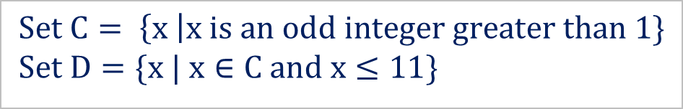
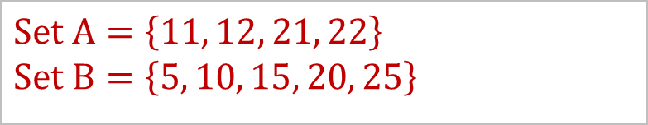
Set Theory
  A set is an unordered collection of distinct objects.
  The objects in a set are called elements or members of the set.
Roster Notation
Set-builder Notation
Example 1
Example 2
$$Set A=\left\{11, 12, 21, 22\right\}$$
$$Set B=\left\{5, 10, 15, 20, 25\right\}$$
$$Set C= \left\{x \right|x is an odd integer greater than 1\}$$
$$Set D=\{x | x∈C and x≤11\}$$

Slide 13




Set Theory
Finite & Infinite sets: A set is finite if it contains a finite number of elements, otherwise it is an infinite set.
Subset: For two sets 𝐴 and 𝐶, we say that 𝐶 is a subset of 𝐴, written as 𝐶⊆𝐴, if each member of set 𝐶 is also a member of set 𝐴.
Example 1
Example 2
$A = \left\{x\right|x∈Z and x^{2}−81=0\}$
$$A =\left\{−9,9\right\}$$
$$B = \left\{x\right|x is divisible by 2\}$$
$$B =\{2,4,6,…,\}$$
Set $A$ is a finite set
Set $B$ is an infinite set

Slide 14
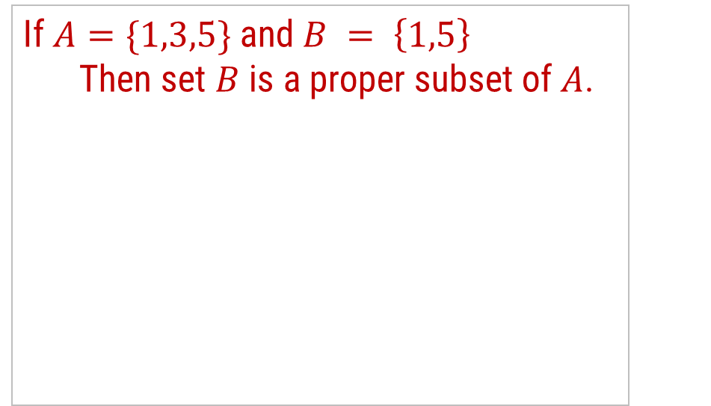




Set Theory
Proper Subset: A proper subset of a set $A$ is a subset of $A$ that is not equal to $A.$
Example 1
Example 2
If $A=\{1,3,5\}$and $B = \left\{1,5\right\}$
  Then set $B$ is a proper subset of $A$.
If $A=\{1,3,5\}$and $C=\left\{1,3,5\right\}$
Then set C is a subset of $A$, but it is not a proper subset of $A$ since $C=A$.
A
B
A=C
$$B\text{⊂}A$$
$$C⊆A$$

Slide 15
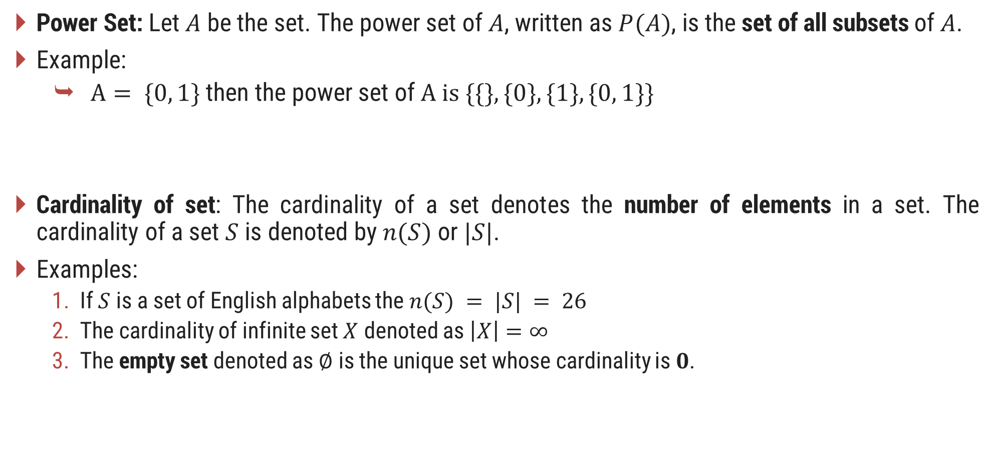
Set Theory
Power Set: Let $A$ be the set. The power set of $A$, written as $P(A)$, is the set of all subsets of $A$.
Example:
  $A= \{0, 1\}$then the power set of $A is \{\{\}, \{0\}, \{1\}, \{0, 1\}\}$
Cardinality of set: The cardinality of a set denotes the number of elements in a set. The cardinality of a set $S$ is denoted by $n(S)$ or $|S|$.
Examples:
  If $S$ is a set of English alphabets the $n(S) = |S| = 26$
  The cardinality of infinite set $X$ denoted as $\left|X\right|=∞$
  The empty set denoted as $∅$ is the unique set whose cardinality is $0$.

Slide 16

Set Theory
Complement: The complement of a set $A$ is the set $A’$ that contains every element of the Universal set U but not in A.
Example:
  Consider $U = \{1, 3, 5, 7, 9\}$and $A = \left\{1, 5\right\}$
  Then $A′= \{3, 7, 9\}$
𝐴′ = {𝑥 | 𝑥 ∈𝑈 𝑎𝑛𝑑 𝑥∉𝐴}
A’
A
U

Slide 17


Set Operations
Union: The union of two different sets $A$ and $B$ is the set of all distinct elements of sets $A$ and $B$.
Example:
  Consider $A = \{1, 3, 5, 7, 9\}$and $B = \{1, 2, 3, 4, 5\}$
    Then $A ∪ B = \{1, 2, 3, 4, 5, 7, 9\}$
  $$A ∪ B = \{x | x ∈ A or x ∈ B\}$$
A
B
A
B

Slide 18
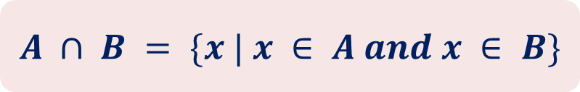

Set Operations
Intersection: The intersection of two sets $A$ and $B$ is the set that contains all elements of $A$ that also belong to $B$ but no other elements.
Example:
  Consider $A = \{1, 3, 5, 7, 9\}$and $B = \{1, 2, 3, 4, 5\}$
    Then $A ∩ B = \{1, 3, 5\}$
$$A ∩ B = \{x | x ∈ A and x ∈ B\}$$
A
B

Slide 19
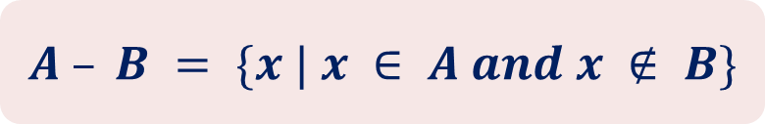

Set Operations
Set Difference: The set difference $A − B$of two sets $A$ and $B$ is the set of elements that are in $A$ but not in $B$.
Example:
  Consider $A = \{1, 3, 5, 7, 9\}$and $B = \{1, 2, 3, 4, 5\}$
    Then $A − B = \{7, 9\}$
$$A – B = \{x | x ∈ A and x ∉ B\}$$
A
B

Slide 20
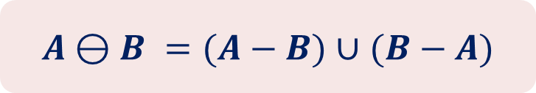
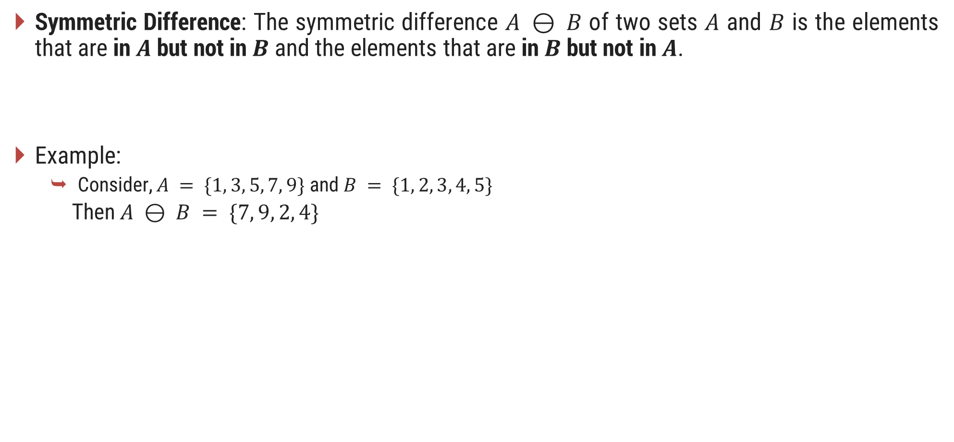
Set Operations
Symmetric Difference: The symmetric difference $A ⊖ B$ of two sets $A$ and $B$ is the elements that are in $A$ but not in $B$ and the elements that are in $B$ but not in $A$.
Example:
  Consider, $A = \{1, 3, 5, 7, 9\}$and $B = \{1, 2, 3, 4, 5\}$
    Then $A ⊖ B = \{7, 9, 2, 4\}$
$$A⊖B =(A−B)∪(B−A)$$
A
B

Slide 21
Set Operations
Sequences: A sequence of objects is a list of objects in some order.
Example: the sequence 7, 21, 57 would be written as (7, 21, 57)
In a set the order does not matter but in a sequence it does.
Repetition is not permitted in a set but repetition is permitted in a sequence. So, (7, 7, 21, 57) is different from (7, 21, 57).
Tuples: Finite sequences are called tuples.
Examples:
  (7, 21) 2-tuple or pair
  (7, 21, 57) 3-tuple
  (7, 21, ..., k ) k-tuple

Slide 22











Set Operations
Cartesian Product: The Cartesian product $A × B$ of two sets $A$ and $B$ is the set of all ordered pairs $(a, b)$where $a∈A$and $b∈B$.
Example:
$$A×B = \{(a, b) | a ∈ A and b ∈ B\}$$
$$A$$
$$\{1,2,3\}$$
$$(1, x)$$
$$(1, y)$$
$$(2, x)$$
$$(2, y)$$
$$B$$
$$\{x, y\}$$
$$(3, x)$$
$$(3, y)$$
$$A×B$$

Slide 23
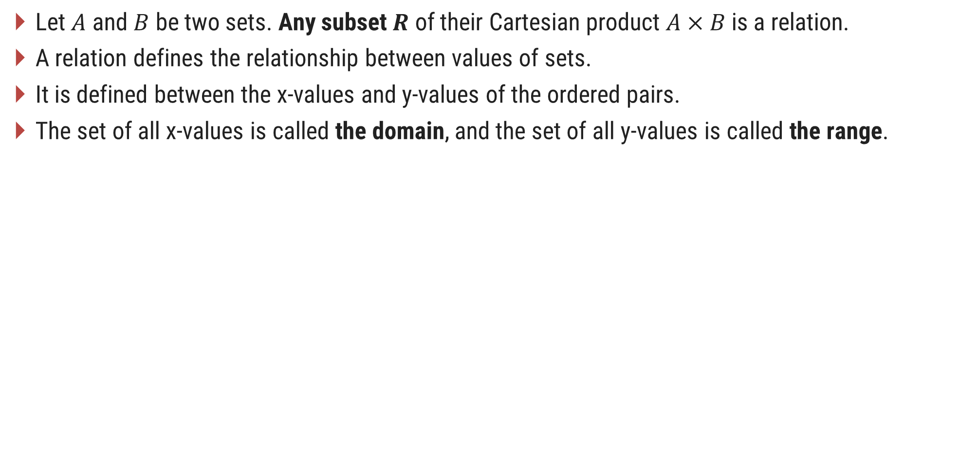
Relation
Let $A$ and $B$ be two sets. Any subset $R$ of their Cartesian product $A×B$is a relation.
A relation defines the relationship between values of sets.
It is defined between the x-values and y-values of the ordered pairs.
The set of all x-values is called the domain, and the set of all y-values is called the range.

Slide 24


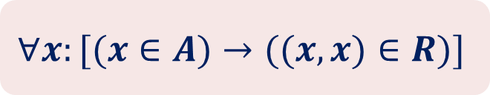

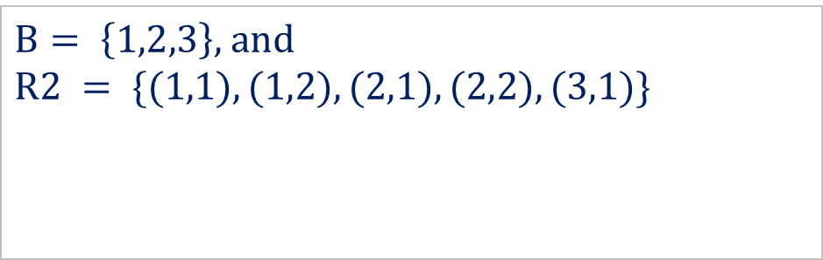
Properties of the Relation
Reflexive: Let $A$ be a set, and let $R$ be a binary relation on $A$. Relation $R$ is reflexive if,
$$∀x:[(x∈A)→((x, x)∈R)]$$
Example 1
Example 2
$A =\{1, 2\}$and $R1 = \{(a,b) | a≤b\}$
so, $R1 = \left\{\left(1,1\right), \left(1,2\right), \left(2,2\right)\right\}$
$B= \left\{1,2,3\right\},$and
$$R2 = \{(1,1), (1,2), (2,1), (2,2), (3,1)\}$$
Reflexive
    Not Reflexive since $(3,3)∉R2$

Slide 25
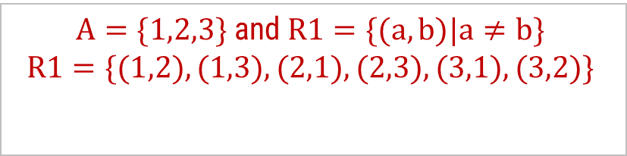

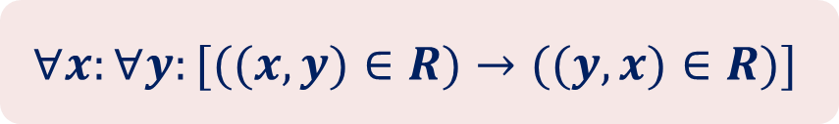
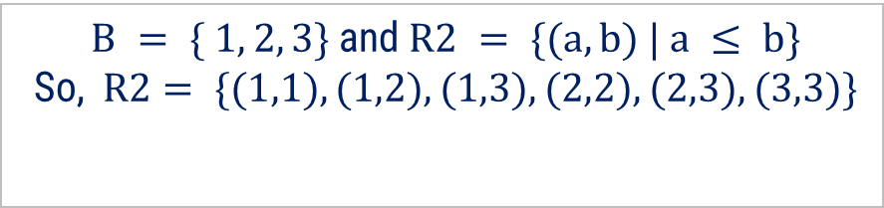
Properties of the Relation
Symmetric: A relation $R$ on a set $A$ is called symmetric if $(y, x)∈R$whenever $(x, y)∈R$, for some $x, y∈A$.
$$∀x:∀y:[((x, y)∈R)→((y, x)∈R)]$$
Symmetric
Asymmetric
Example 1
Example 2
  $A=\{1,2,3\}$and $R1=\{(a,b)|a≠b\}$
  $$R1=\{(1,2),(1,3),(2,1),(2,3),(3,1),(3,2)\}$$
$B = \{ 1, 2, 3\}$and $R2 = \{(a,b) | a ≤ b\}$
So, $R2= \{(1,1), (1,2), (1,3), (2,2),(2,3),(3,3)\}$

Slide 26


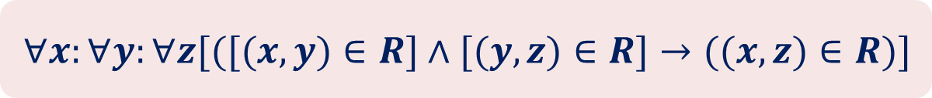
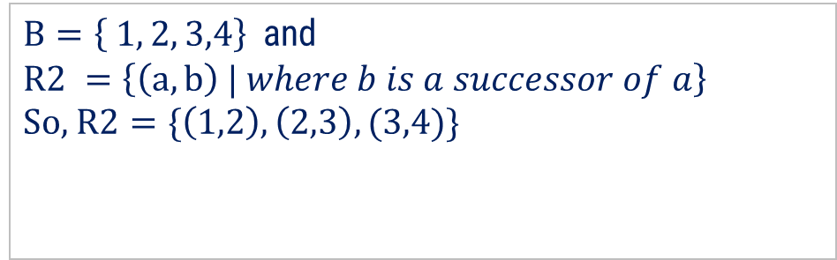
Properties of the Relation
Transitive: A relation $R$ on a set $A$, is called transitive if whenever $(x,y)∈R$and $(y,z)∈R$, then $(x,z)∈R$, for $x, y, z∈A$.
$$∀x:∀y:∀z[([(x, y)∈R]∧[(y, z)∈R]→((x, z)∈R)]$$
Transitive
Not Transitive
Example 1
Example 2
  $A=\{ 1, 2, 3\}$and $R1=\{(a,b) | a ≤ b\}$
So, $R1=\{(1,1), (1,2), (1,3), (2,2),(2,3),(3,3)\}$
$B=\left\{ 1, 2, 3,4\right\}$and
$$R2 =\left\{\left(a,b\right) | where b is a successor of a\right\}$$
So, $R2=\{\left(1,2\right), \left(2,3\right),(3,4)\}$

Slide 27
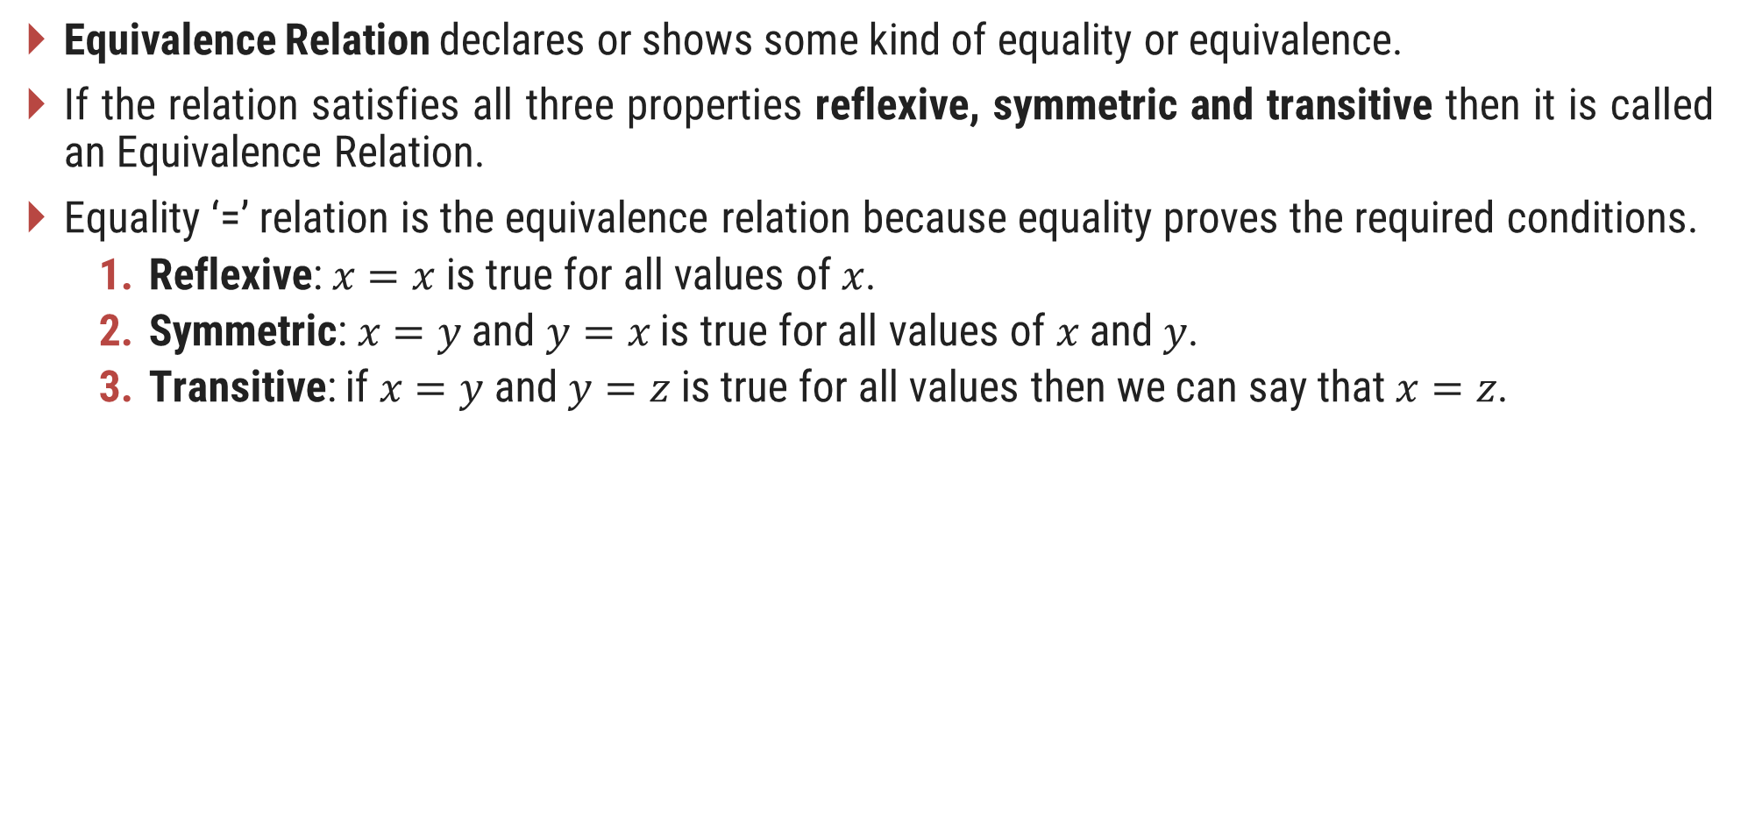
Equivalence Relation
Equivalence Relation declares or shows some kind of equality or equivalence.
If the relation satisfies all three properties reflexive, symmetric and transitive then it is called an Equivalence Relation.
Equality ‘=’ relation is the equivalence relation because equality proves the required conditions.
  Reflexive: $x=x$ is true for all values of $x$.
  Symmetric: $x=y$ and $y=x$ is true for all values of $x$ and $y$.
  Transitive: if $x=y$ and $y=z$ is true for all values then we can say that $x=z$.

Slide 28

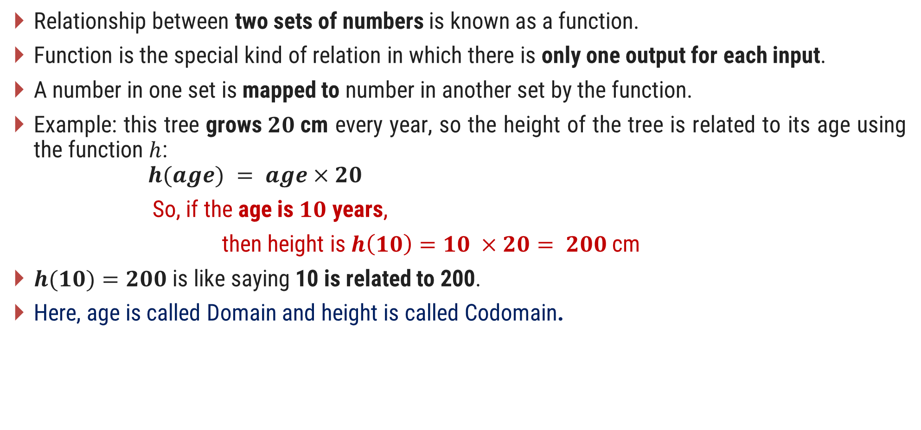
Functions
Relationship between two sets of numbers is known as a function.
Function is the special kind of relation in which there is only one output for each input.
A number in one set is mapped to number in another set by the function.
Example: this tree grows$20$cm every year, so the height of the tree is related to its age using the function $h$:
$$h(age) = age×20$$
So, if the age is $10$ years,
then height is $h\left(10\right)=10 ×20= 200$cm
$h(10)=200$is like saying 10 is related to 200.
Here, age is called Domain and height is called Codomain.

Slide 29


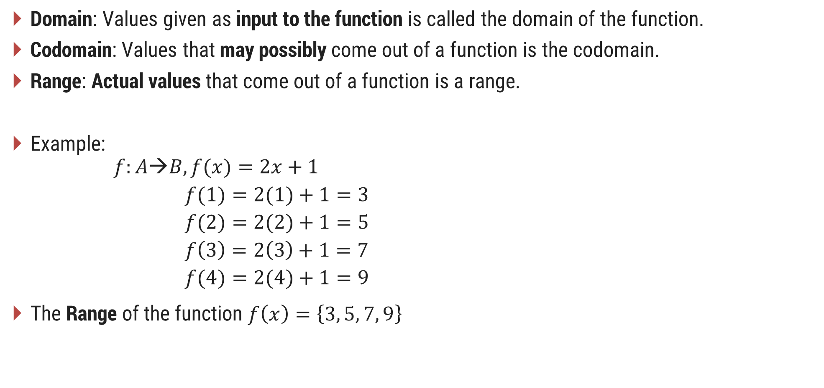



Function Notations
Domain: Values given as input to the function is called the domain of the function.
Codomain: Values that may possibly come out of a function is the codomain.
Range: Actual values that come out of a function is a range.
Example:
  $$f:A→B, f(x)=2x+1$$
  $$f(1)=2(1)+1=3$$
  $$f(2)=2(2)+1=5$$
  $$f\left(3\right)=2\left(3\right)+1=7$$
  $$f(4)=2(4)+1=9$$
The Range of the function $f\left(x\right)=\left\{3, 5, 7, 9\right\}$
Codomain
$$1$$
2
3
4
5
6
7
8
9
10
Domain
$$1$$
$$2$$
$$3$$
$$4$$
Domain
Codomain

Slide 30
Relation & Function
Relation 1
Relation 2
Is not a function since elements of domain point to multiple elements of codomain.
Is a function since elements of domain point to only one element of codomain.
Ana
Mit
Sam
Yug
Jen
Tom
Ram
Neel
CX
CY
CZ
Ana
Yug
Ram
Mit
CX
CY
CZ
Division (Domain)
Students (Codomain)
Students (Domain)
Division (Codomain)

Slide 31





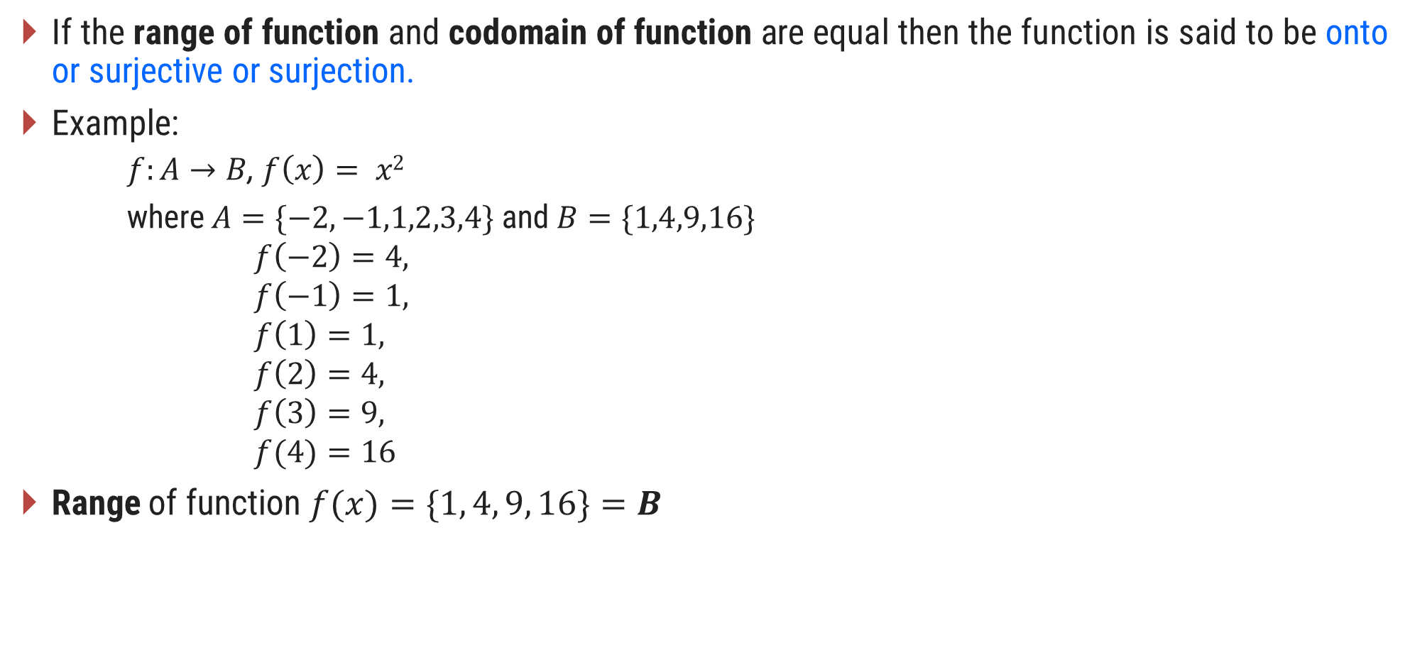







Functions Types
If the range of function and codomain of function are equal then the function is said to be onto or surjective or surjection.
Example:
  $f:A→B$, $f\left(x\right)= x2$
    where $A=\{−2,−1,1,2,3,4\}$and $B=\{1,4,9,16\}$
      $$f\left(−2\right)=4,$$
      $$f\left(−1\right)=1,$$
      $$f\left(1\right)=1,$$
      $$f\left(2\right)=4,$$
      $$f\left(3\right)=9,$$
      $$f(4)=16$$
Range of function $f(x)=\{1, 4, 9, 16\}=B$
Codomain
$$A$$
$$B$$
-$2$
-$1$
$$1$$
$$1$$
$$4$$
$$2$$
$$9$$
$$3$$
$$4$$
$$16$$

Slide 32











Functions Types
A function $f:A→B$is injective or one-to-one if there do not exist two distinct $x1$and$x2$such that $f(x1)=f(x2).$
Example:
  The function $f:A →B$, $f(x)=x+1$is a one-to-one function,
  where $A=\{1, 2, 3, 4\}$and $B=\{2, 3, 4, 5\}$
$$1$$
$$2$$
$$2$$
$$3$$
$$3$$
$$4$$
$$4$$
$$5$$
$$A$$
$$B$$

Slide 33



Functions Types
If function is both one-to-one and onto then the function is called Bijection function.
Example:
function $f :A→B, f(x)=x+1$
where $A=\{1,2,3,4,5\}$and $B=\{2,3,4,5,6\}$
        $$f\left(1\right)=2$$
        $f(2) =$3
        $f(3) =$4
        $f(4) =$5
        $f(5) =$6
$$A$$
$$B$$
1
2
2
3
3
4
4
5
5
6

Slide 34
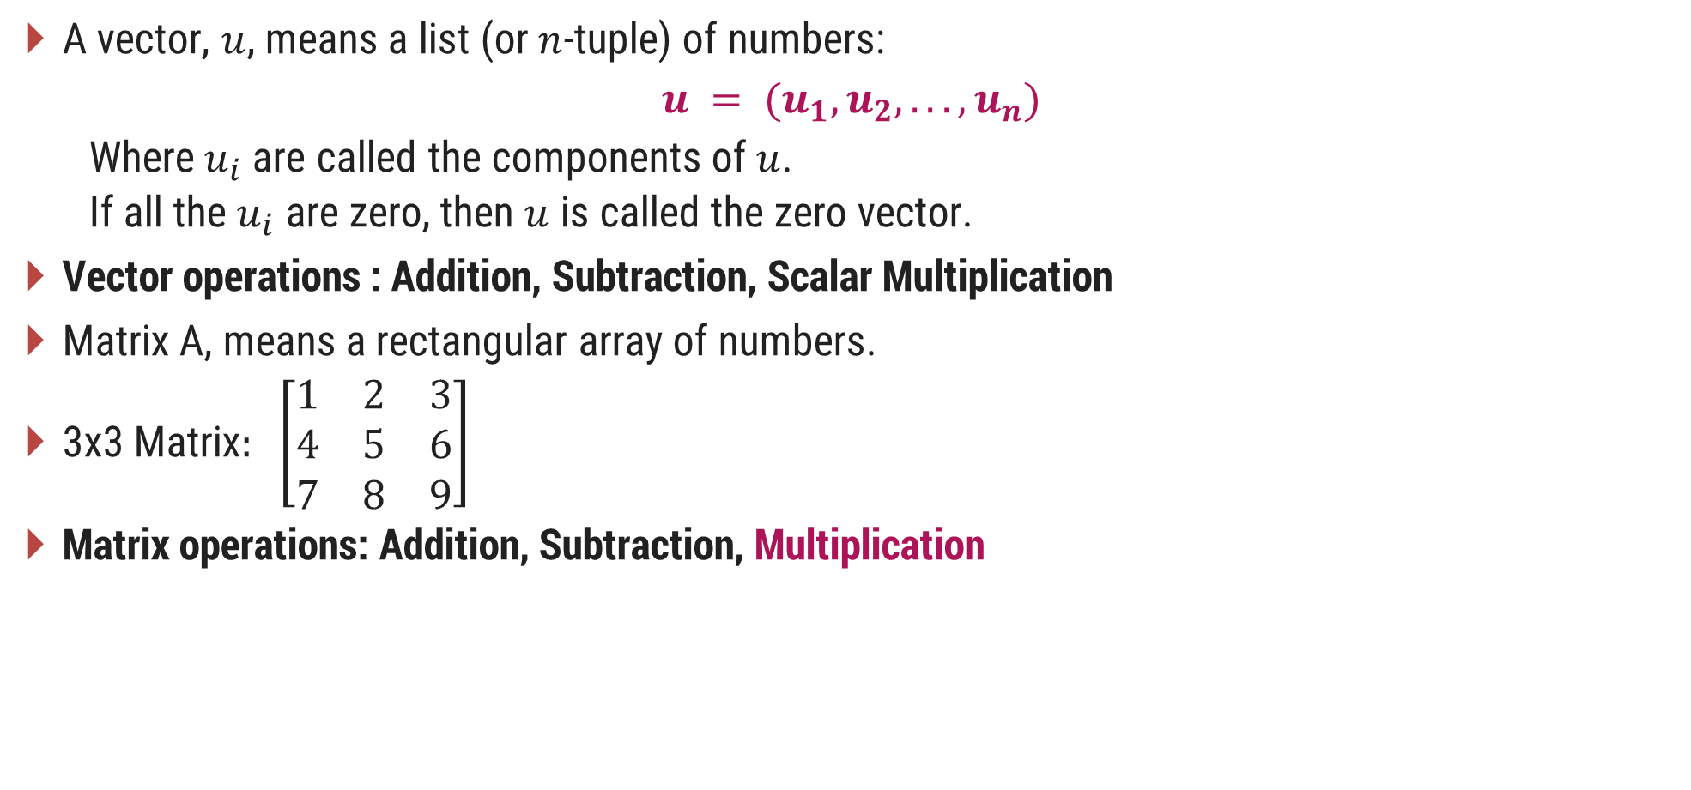
Vectors and Matrices
A vector, $u$, means a list (or $n$-tuple) of numbers:
  $$u = (u_{1}, u_{2}, . . . , u_{n})$$
  Where$u_{i}$are called the components of $u$.
  If all the $u_{i}$ are zero, then $u$ is called the zero vector.
Vector operations : Addition, Subtraction, Scalar Multiplication
Matrix A, means a rectangular array of numbers.
3x3 Matrix$: \left[\begin{matrix}1 & 2 & 3 \\ 4 & 5 & 6 \\ 7 & 8 & 9\end{matrix}\right]$
Matrix operations: Addition, Subtraction, Multiplication

Slide 35

Linear Inequalities
Inequalities: The term inequality is applied to any statement involving one of the symbols <, >, ≤, ≥.
Examples of inequalities are:
  $x≥1$
  $x + y + 2z > 16$
  $p2 + q2 ≤1/2$
  $a2 + ab > 1$

Slide 36

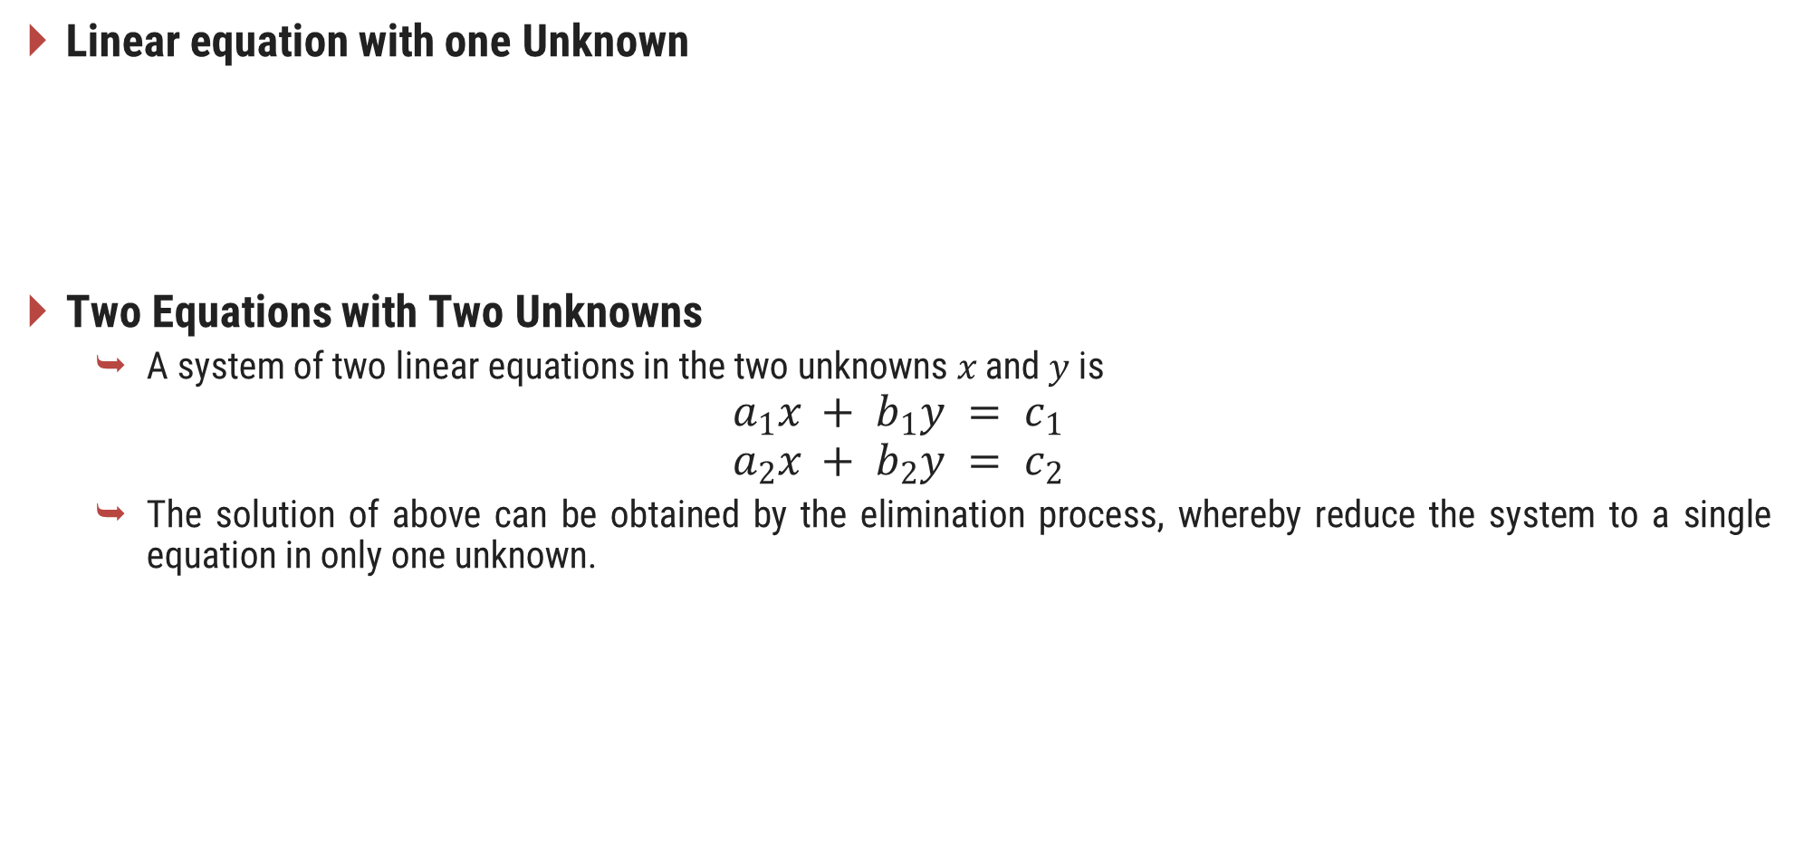
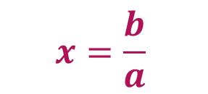
Linear Equations
Linear equation with one Unknown
Two Equations with Two Unknowns
  A system of two linear equations in the two unknowns $x$ and $y$ is
$$a_{1}x + b_{1}y = c_{1}$$
$$a_{2}x + b_{2}y = c_{2}$$
  The solution of above can be obtained by the elimination process, whereby reduce the system to a single equation in only one unknown.
$$x=\frac{b}{a}$$
$$ax = b$$
Solution

Slide 37
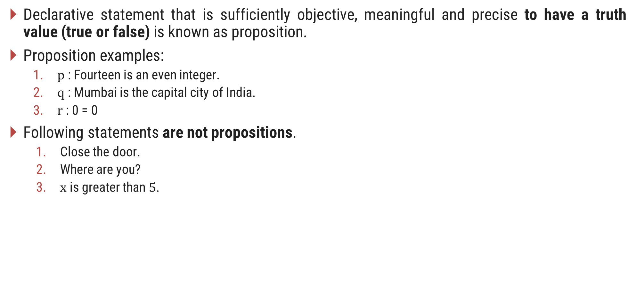
Logic
Declarative statement that is sufficiently objective, meaningful and precise to have a truth value (true or false) is known as proposition.
Proposition examples:
  $p$ : Fourteen is an even integer.
  $q$ : Mumbai is the capital city of India.
  $r$ : 0 = 0
Following statements are not propositions.
  Close the door.
  Where are you?
  $x$ is greater than $5$.

Slide 38



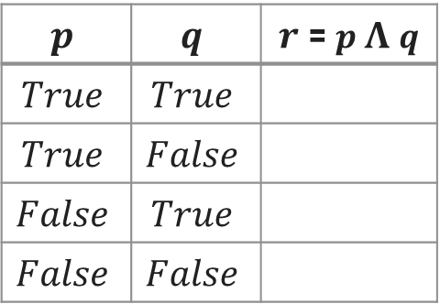



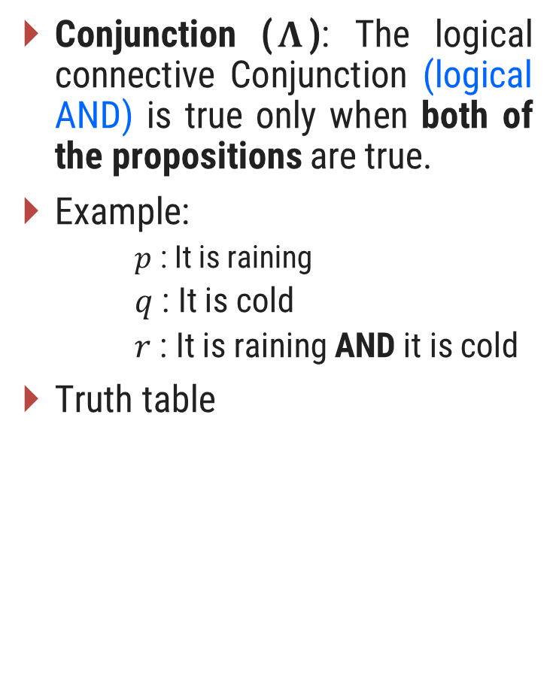








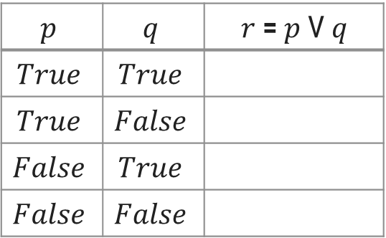

Logical Connectives
Conjunction ($\text{Ʌ}$): The logical connective Conjunction (logical AND) is true only when both of the propositions are true.
Example:
  $p$ : It is raining
    $q$ : It is cold
    $r$ : It is raining AND it is cold
Truth table
Disjunction ($V$): The logical disjunction, or logical OR, is true if one or both of the propositions are true.
Example:
  $$p : 2+2=5$$
    $$q : 1<2$$
    $$r : 2+2=5 OR 1<2$$
Truth table
Negation (¬): $➢p$, the negation of a proposition $p$, is also a proposition.
Example:
  $p$ : John studies.
    $➢ p$:John does NOT study.
Truth table
$$p$$ | $$q$$ | $r$ = $p \text{Ʌ} q$
$$True$$ | $$True$$
$$True$$ | $$False$$
$$False$$ | $$True$$
$$False$$ | $$False$$
$$p$$ | $$q$$ | $r$ = $p$ V $q$
$$True$$ | $$True$$
$$True$$ | $$False$$
$$False$$ | $$True$$
$$False$$ | $$False$$
$$p$$ | $$➢ p$$
$$True$$
$$True$$
$$True$$
$$False$$
$$False$$
$$True$$
$$False$$
$$True$$
$$False$$
$$True$$
$$False$$
$$False$$

Slide 39
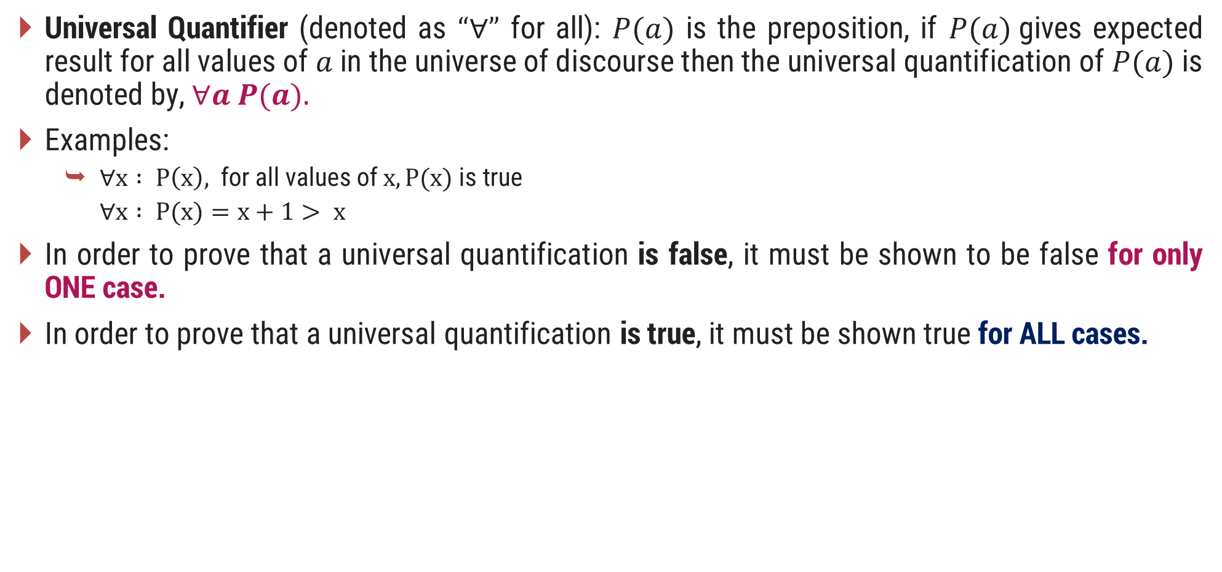
Logical Quantifiers
Universal Quantifier (denoted as $“∀”$ for all): $P(a)$ is the preposition, if $P(a)$gives expected result for all values of $a$ in the universe of discourse then the universal quantification of $P(a)$ is denoted by, $∀a P(a).$
Examples:
  $∀x : P\left(x\right),$ for all values of $x, P(x)$is true
  $∀x : P(x)=x+1> x$
In order to prove that a universal quantification is false, it must be shown to be false for only ONE case.
In order to prove that a universal quantification is true, it must be shown true for ALL cases.

Slide 40

Logical Quantifiers
Existential Quantifier (denoted as $“”$ for some): $P(a)$is the preposition, if there exits an element $a$ in the universe of discourse such that $P(a)$is giving expected result then the Existential Quantification of $P(a)$ is represented by, $∃a P(a).$
Example:
  Let $P(x) = x/2 < x$
    There exists a numerical value for which $x/2 < x$is true
    Thus, $ x : P(x)$is true
In order to show an existential quantification is true, it must be shown true for only ONE value.
In order to show an existential quantification is false, it must be show false for ALL values.

Slide 41
Q and A

