Slide 1

KINEMATICS & DYNAMICS OF MACHINES (KDM)
L. E. College, Morbi-2
Mechanical Engineering Department
Chapter– Gear trains
Prepared by Prof. Divyesh B. Patel
Mechanical Engg. Dept
LE. College, Morbi
+919925282644
divyesh21dragon@gmail.com

Slide 2
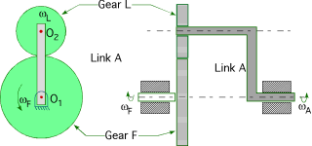
Gear Trains
Prepared by Prof. D.B.Patel
Mechanical Engg. Dept
LE. College, Morbi
2.4. Epicyclic Gear Train
A simple epicyclic gear train is shown in Fig., where a gear F and the arm (link)A have a common axis at O₁ about which they can rotate. The gear L meshes with gear F and has its axis on the arm at O₂, about which the gear L can rotate. If the arm is fixed, the gear train is simple and gear F can drive gear L or vice- versa, but if gear F is fixed and the arm is rotated about the axis of gear F (i.e. O₁), then the gear L is forced to rotate upon and around gear F. Such a motion is called epicyclic and the gear trains arranged in such a manner that one or more of their members move upon and around another member are known as epicyclic gear trains (epi. means upon and cyclic means around). The epicyclic gear trains may be simple or compound.

Slide 3
Gear Trains
Prepared by Prof. D.B.Patel
Mechanical Engg. Dept
LE. College, Morbi
2.4. Epicyclic Gear Train
Step No. | Conditions of motion | Revolutions of elements
 |  | Arm A | Gear F | Gear L
1 | Arm fixed-gear F rotates through + 1 revolution i.e. 1 rev. anticlockwise | 0 | + 1 | - T_{F}/T_{L}
2 | Arm fixed-gear A rotates through + x revolutions | 0 | + x | - x×T_{F}/T_{L}
3 | Add + y revolutions to all elements | + y | +y | + y
4 | Total motion | +y | x + y | y - x×T_{F}/T_{L}

Slide 4
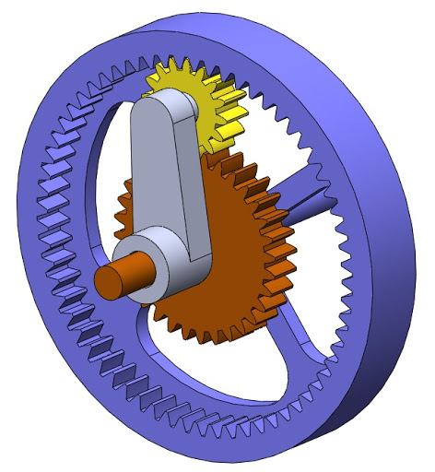
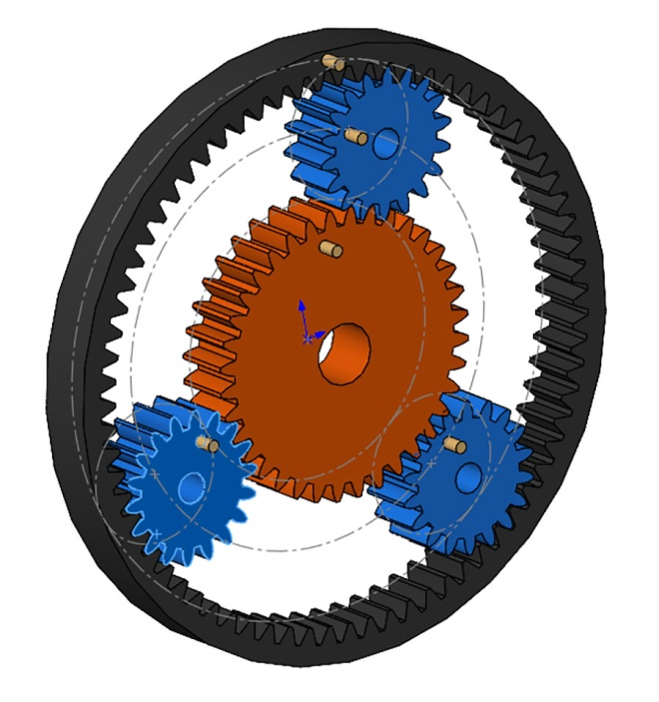
Gear Trains
Prepared by Prof. D.B.Patel
Mechanical Engg. Dept
LE. College, Morbi
2.4. Compound Epicyclic Gear Train—
Sun and Planet Gear
Annulus Gear
Arm
Sun Gear
Planet
Gear

Slide 5
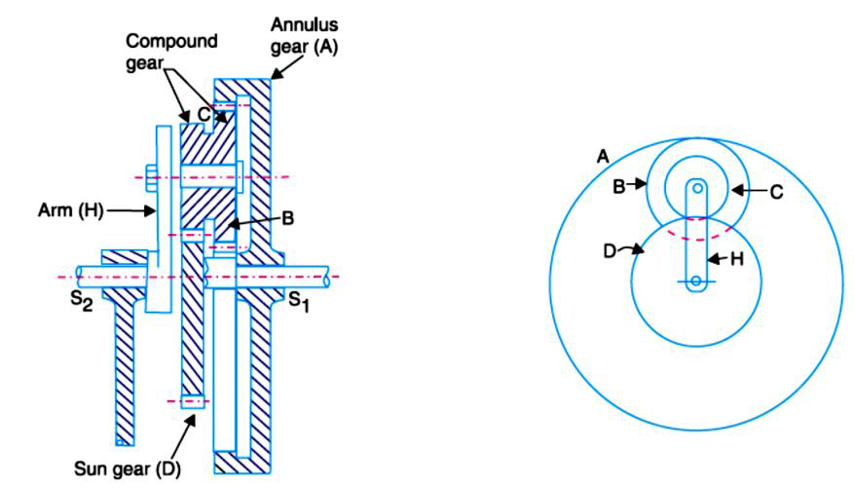
Gear Trains
Prepared by Prof. D.B.Patel
Mechanical Engg. Dept
LE. College, Morbi
2.4. Compound Epicyclic Gear Train—
Sun and Planet Gear

Slide 6
Gear Trains
Prepared by Prof. D.B.Patel
Mechanical Engg. Dept
LE. College, Morbi
2.4. Compound Epicyclic Gear Train—
Sun and Planet Gear
Step No. | Conditions of motion | Revolutions of elements
 |  | Arm H | Gear D | Compound Gear B-C | Gear A
1 | Arm fixed-gear D rotates through + 1 revolution i.e. 1 rev. anticlockwise | 0 | + 1 | - T_{D}/T_{C} | - T_{D}/T_{C}×T_{A}/T_{B}
2 | Arm fixed-gear D rotates through + x revolutions | 0 | + x | - x×T_{D}/T_{C} | - x×T_{D}/T_{C}×T_{A}/T_{B}
3 | Add + y revolutions to all elements | + y | +y | + y | + y
4 | Total motion | +y | x + y | y - x×T_{D}/T_{C} | y - x×T_{D}/T_{C}×T_{A}/T_{B}
Note : If the annulus gear A is rotated through one revolution anticlockwise with the arm fixed, then the compound gear rotates through T_{A} / T_{B} revolutions in the same sense and the sun gear D rotates through T_{A} / T_{B} × T_{C} / T_{D} revolutions in clockwise direction.

Slide 7
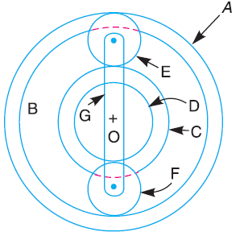
Example -1
In an epicyclic gear train, the internal wheels A and B and compound wheels C and D rotate independently about axis O. The wheels E and F rotate on pins fixed to the arm G. E gears with A and C and F gears with B and D. All the wheels have the same module and the number of teeth are : T_{C}= 28; T_{D}= 26;T_{E}= T_{F}= 18.
1). Sketch the arrangement ; 2). Find the number of teeth on A and B ; 3). If the arm G makes 100 r.p.m. clockwise and A is fixed, find the speed of B ; and 4). If the arm G makes 100 r.p.m. clockwise and wheel A makes 10 r.p.m. counter clockwise ; find the speed of wheel B.

Slide 8
2. Number of teeth on wheels A and B
Let T_{A} = Number of teeth on wheel A, and
T_{B} = Number of teeth on wheel B.
If d_{A} , d_{B} , d_{C} , d_{D} , d_{E} and d_{F} are the pitch circle diameters of wheels A, B, C, D, E and F respectively, then from the geometry of Fig.
d_{A} = d_{C} + 2 d_{E} and d_{B} = d_{D} + 2 d_{F}
Since the number of teeth are proportional to their pitch circle diameters, for the same module, therefore
T_{A} = T_{C} + 2 T_{E} = 28 + 2 × 18 = 64 Ans.
and T_{B} = T_{D} + 2 T_{F} = 26 + 2 × 18 = 62 Ans.

Slide 9
Step No. | Conditions of motion | Revolutions of elements
 |  | Arm G | Wheel A | Wheel E | Compound Gear C-D | Wheel F | Wheel B
1 | Arm fixed-gear D rotates through + 1 revolution i.e. 1 rev. anticlockwise | 0 | + 1 | - T_{A}/T_{E} | -T_{A}/T_{E}×T_{E}/T_{C} = - T_{A}/T_{C} | +T_{A}/T_{C}×T_{D}/T_{F} | + T_{A}/T_{C}×T_{D}/T_{F}×T_{F}/T_{B} = T_{A}/T_{C}×T_{D}/T_{B}
2 | Arm fixed-gear A rotates through + x revolutions | 0 | + x | - x×T_{A}/T_{E} | - x×T_{A}/T_{C} | +x×T_{A}/T_{C}×T_{D}/T_{F} | + x×T_{A}/T_{C}×T_{D}/T_{B}
3 | Add + y revolutions to all elements | + y | +y | + y | + y | + y | + y
4 | Total motion | +y | x + y | y - x×T_{A}/T_{E} | y - x×T_{A}/T_{C} | y +x×T_{A}/T_{C}×T_{D}/T_{F} | y + x×T_{A}/T_{C}×T_{D}/T_{B}

Slide 10
3. Speed of wheel B when arm G makes 100 r.p.m. clockwise and wheel A is fixed
Since the arm G makes 100 r.p.m. clockwise, therefore from the fourth row of the table,
y = – 100 ...(i)
Also, the wheel A is fixed, therefore from the fourth row of the table,
x + y = 0 or x = – y = 100 ...(ii)
Speed of wheel B = y + x×T_{A}/T_{C}×T_{D}/T_{B} = – 100 + 100 × 64/28 × 26/62 = – 100 + 95.8
= – 4.2 r.p.m. = 4.2 r.p.m. clockwise

Slide 11
4. Speed of wheel B when arm G makes 100 r.p.m. clockwise and wheel A makes 10 r.p.m. counter clockwise
Since the arm G makes 100 r.p.m. clockwise, therefore from the fourth row of the
table
y = – 100 ...(iii)
Also the wheel A makes 10 r.p.m. counter clockwise, therefore from the fourth row of thet able,
x + y = 10 or x = 10 – y = 10 + 100 = 110 ...(iv)
Speed of wheel B = y + x×T_{A}/T_{C}×T_{D}/T_{B} = - 100 + 110 × 64/28 × 26/62 = - 100 + 105.4
= + 5.4 r.p.m. = 5.4 r.p.m. counter clockwise

Slide 12
Thank you

