Slide 1

KINEMATICS & DYNAMICS OF MACHINES (KDM)
L. E. College, Morbi-2
Industrial Engineering Department
Chapter-01– Introduction of Mechanisms and Machines
Prepared by Prof. Divyesh B. Patel
Mechanical Engg. Dept
LE. College, Morbi
+919925282644
divyesh21dragon@gmail.com

Slide 2
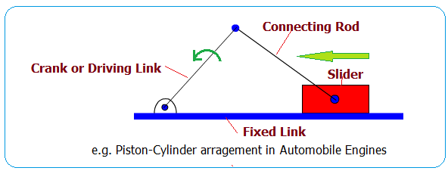
Slider -crank

Slide 3
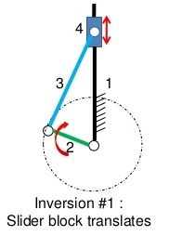
Inversion of slider -crank
First inversion
This inversion is obtained when link 1 is fixed and links 2 and 4 are made the crank and slider respectively.
Applications:
Reciprocating engine
Reciprocating compressor

Slide 4
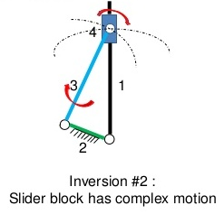
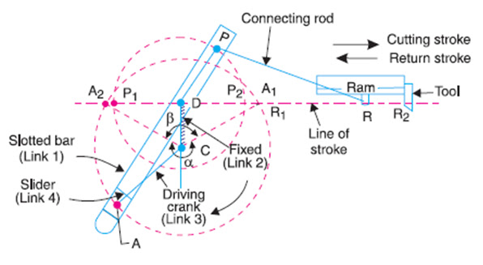
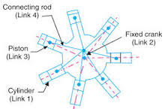
Inversion of slider -crank
Second inversion
Fixing of the link 2 of a slider-crank chain results in the second inversion.
Applications:
Whitworth quick-return mechanism
Rotary engine

Slide 5
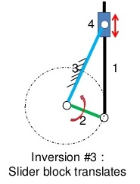
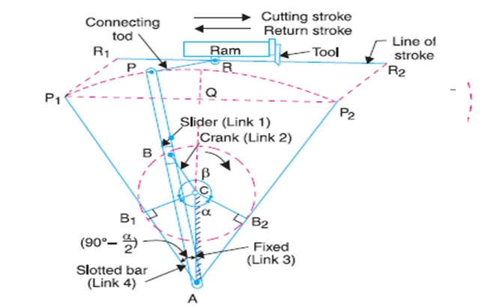
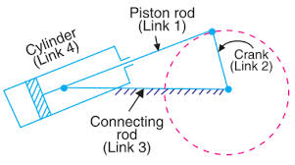
Inversion of slider -crank
Third Inversion
By Fixing of the link 3 of the slider-crank mechanism, the third inversion is obtained. Now the link 2 again acts as a crank and the link 4 oscillates.
Applications:
Oscillating cylinder engine
Crank and slotted-lever mechanism

Slide 6
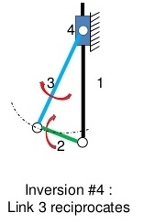
Inversion of slider -crank
Fourth Inversion
If the link 4 of the slider-crank mechanism is fixed, the fourth inversion is obtained. Link 3 can oscillates about the fixed pivot B on the link 4. This makes the end A of the link 2 to oscillate about B and the end O to reciprocate along the axis of the fixed link 4.
Application:
Hand Pump

Slide 7


Slide 8
Double Slider -crank
A kinematic chain which consists of two turning pairs and two sliding pairs is known as double slider crank chain

Slide 9
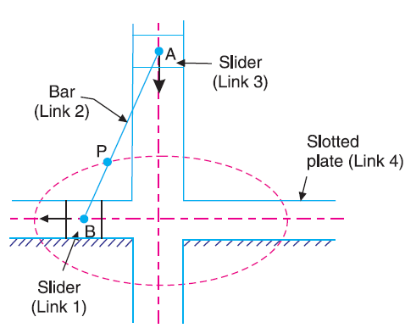
Inversion of double slider -crank
1. Elliptical trammels

Slide 12
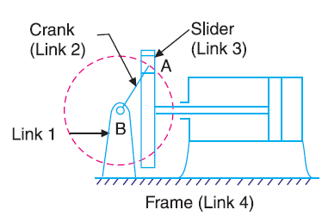
Inversion of double slider -crank
2.Scotch yoke mechanism

Slide 14
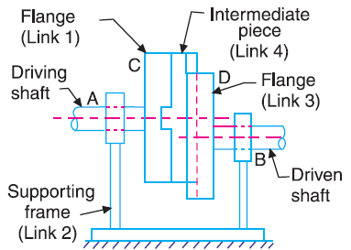
Inversion of double slider -crank
3. Oldham’s coupling

Slide 16
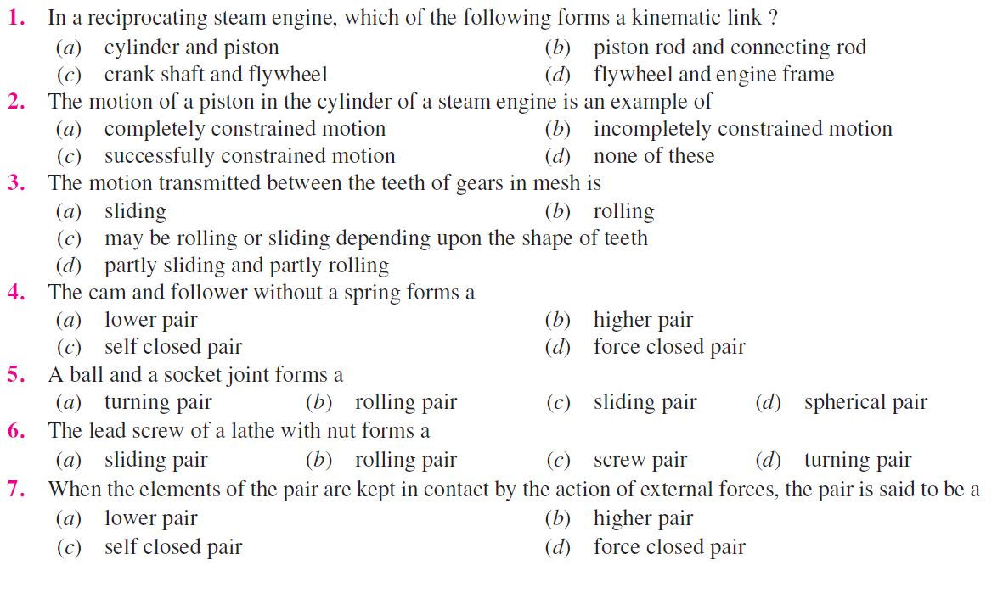

Slide 17
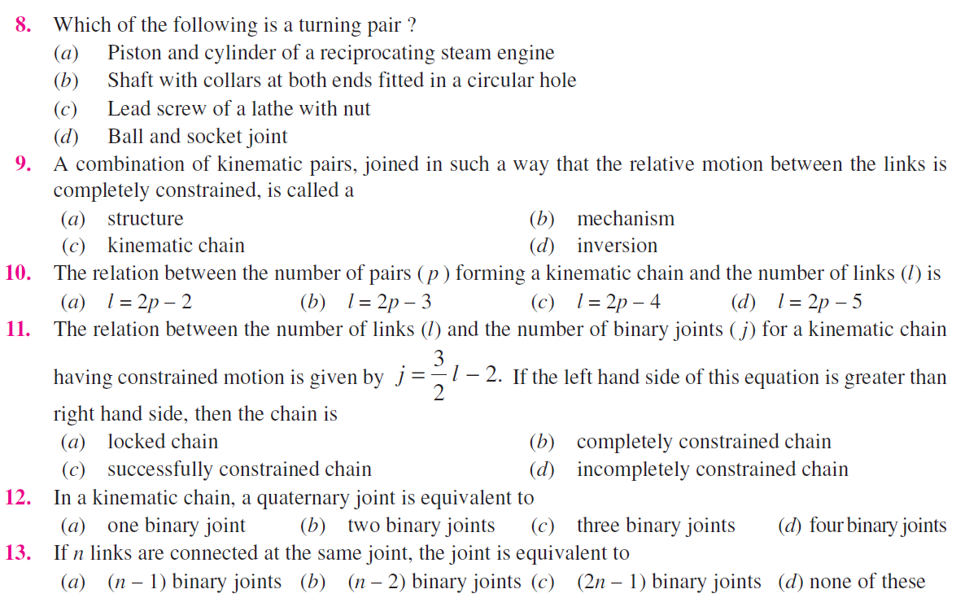

Slide 18
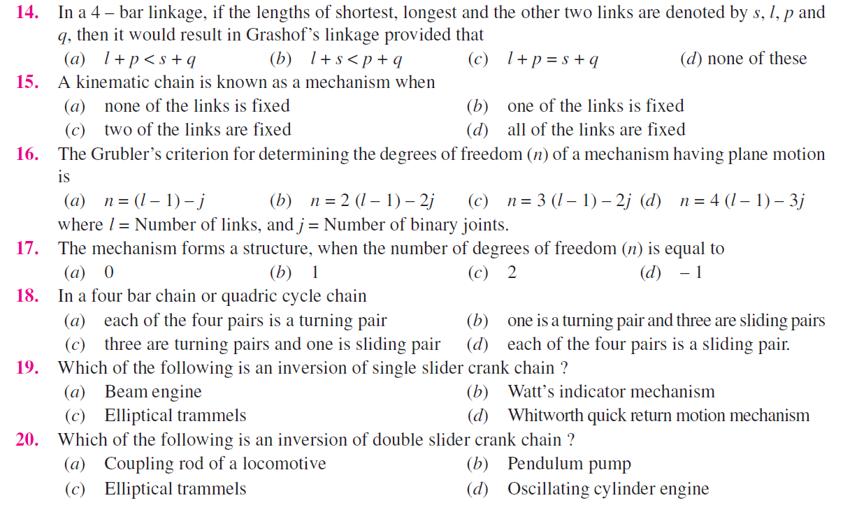

Slide 19
Thank you

