Slide 1
Cement & Ceramic Industries
N. M. Sharma

Slide 2
Cement & Its types, Settling & Hardening of Cement,
Cement manufacturing by wet & dry process.
Introduction to Ceramic Industry,
Manufacturing of Building bricks,
Refractory & its types.

Slide 3

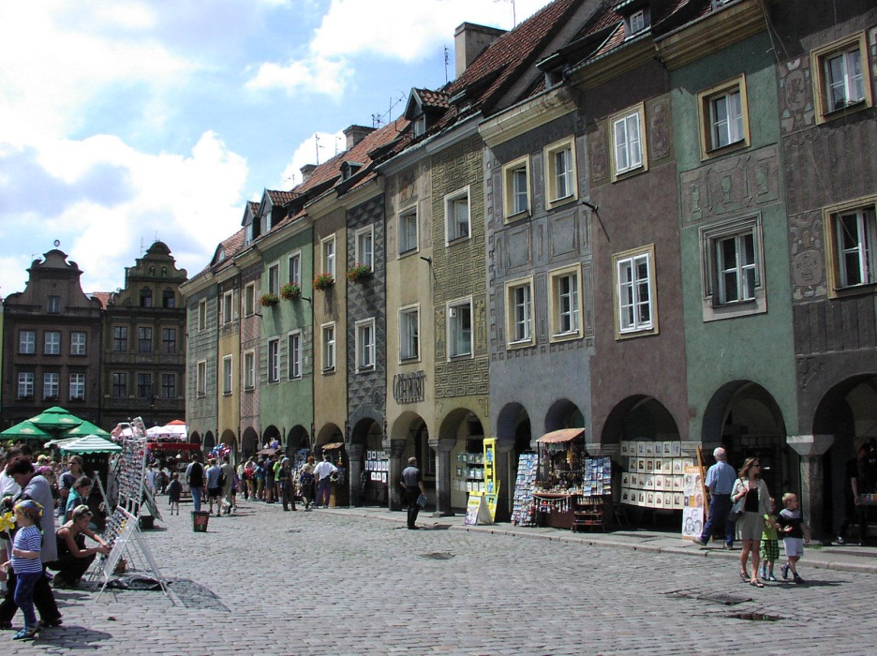
Cement
“Cement is a crystalline compound of calcium silicates and other calcium compounds having hydraulic properties”
Cement is the mixture of
calcareous, siliceous, argillaceous and other substances. Cement is used as a binding material in mortar, concrete, etc.

Slide 4
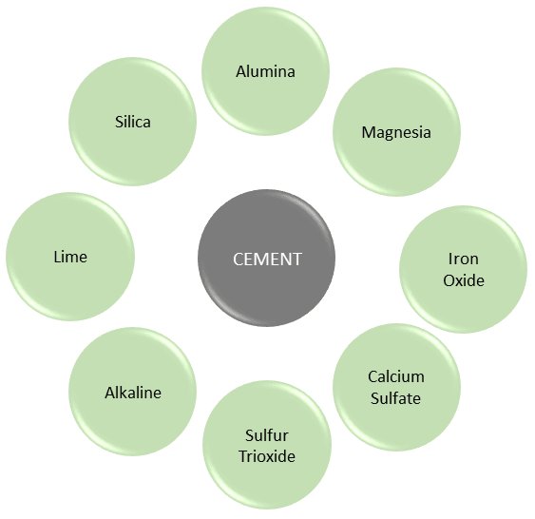
CONSTITUENTS OF CEMENT

Slide 5
Chemical Composition of cement is:
Lime (CaO) 62-63%
Silica (SiO₂) 22%
Alumina (Al₂O₃) 05-06%
Iron oxide (Fe₂O₃) 03%
Magnesia (MgO) 01%
Gypsum (CaSO₄) 01 to 04%
Alkalis 01%

Slide 6
Functions of Cement Ingredients
Lime:
Lime is calcium oxide or calcium hydroxide.
  The presence of lime in a sufficient quantity is required to form silicates and aluminates of calcium.
  Deficiency in lime reduces the strength of the property to the cement.
  Deficiency in lime causes the cement to set quickly.
  Excess lime makes cement unsound.
  The excessive presence of lime causes the cement to expand and disintegrate.

Slide 7
Silica:
Silicon dioxide is known as silica, chemical formula SiO₂.A sufficient quantity of silica should be present in cement to dicalcium and tricalcium silicate.
Silica imparts strength to cement.
Silica usually presents to the extent of about 30 percent cement.

Slide 8
Alumina:
Alumina is Aluminium oxide. The chemical formula is Al₂O₃.Alumina imparts quick setting property to the cement.
Clinkering temperature is lowered by the presence of the requisite quantity of alumina.
Excess alumina weakens the cement.
Magnesia:
Magnesium Oxide. The chemical formula is MgO. Magnesia should not be present more than 2% in cement.
Excess magnesia will reduce the strength of the cement.

Slide 9
Iron oxide:
Chemical formula is Fe₂O₃.Iron oxide imparts color to cement.
It acts as a flux.
At a very high temperature, it imparts into the chemical reaction with calcium and aluminum to form tricalcium alumino-ferrite.
Tricalcium alumino-ferrite imparts hardness and strength to cement.
Calcium Sulfate:
Chemical formula is CaSO₄This is present in cement in the form of gypsum(CaSO₄.2H₂O)
It slows down or retards the setting action of cement.

Slide 10
Sulfur Trioxide:
Chemical formula is SO₃It should not be present for more than 2%.
Excess Sulfur Trioxide causes the cement to unsound.
Alkaline:
- It should not be present more than 1%.
  Excess Alkaline matter causes efflorescence.

Slide 11
Name of Compound. | Formula | Abbreviated
Tricalcium silicate | 3 CaO.SiO₂ | C₃S –hydrates rapidly; provides early & ultimate Strength
Dicalcium silicate | 2 CaO.SiO₂ | C₂S-hydraes slowly & provides strength after a duration of 7 days
Tricalcium aluminate | 3 CaO.Al₂O₃ | C₃A-hydrates rapidly; provides early strength & less ultimate strength
Tetracalcium aluminoferrite | 4 CaO.Al₂O₃.Fe₂O₃ | C₄AF-doesn’t provide strength but is stable than C₃A

Slide 12
TYPES OF CEMENT
Ordinary Portland Cement
Rapid Hardening Cement (or) High Early Strength cement
Extra Rapid Hardening Cement
Sulphate Resisting Cement
Quick Setting Cement
Low Heat Cement
Portland Pozzolana Cement

Slide 13
TYPES OF CEMENT
Portland Slag Cement
High Alumina Cement
Air Entraining Cement
Supersulphated Cement
Masonry Cement
Expansive Cement
Colored Cement
White Cement

Slide 14
(1) ORDINARY PORTLAND CEMENT:
It is called Portland cement because on hardening (setting) its colour resembles to rocks near Portland in England. It was first of all introduced in 1824 by Joseph Asp din, England.
Most important and Common type
Classified into three grades, namely 33 grade, 43 grade and 53 grade.

Slide 15
Chemical Composition of O. P. Cement:
O.P.C has the following approximate chemical composition:
The major constituents are:
1. Lime (CaO) 60- 63%
2. Silica (SiO₂) 17- 25%
3. Alumina (Al₂O₃) 03- 08%
The auxiliary constituents are:
1. Iron oxide (Fe₂O₃) 0.5- 06%
2. Magnesia (MgO) 1.5- 03%
3. Sulphur Tri Oxide (SO₃) 01- 02%
4. Gypsum 01 to 04%

Slide 16
(1) Lime (CaO):
Lime forms nearly two-third (2/3) of the cement. Therefore sufficient quantity of the lime must be in the raw materials for the manufacturing of cement.
Its proportion has an important effect on the cement. Sufficient quantity of lime forms dicalcium silicate and tri-calcium silicate in the manufacturing of cement.
Lime in excess, causes the cement to expand and disintegrate.

Slide 17
(2) Silica (SiO₂):
The quantity of silica should be enough to form di-calcium silicate and tri-calcium silicate in the manufacturing of cement.
Silica gives strength to the cement.
Silica in excess causes the cement to set slowly.
(3) Alumina (Al₂O₃):
Alumina supports to set quickly to the cement.
Lowers the clinkering temperature.
Alumina in excess, reduces the strength of the cement.

Slide 18
(4) Iron Oxide (Fe₂O₃):
Iron oxide gives colour to the cement.
(5) Magnesia (MgO):
It also helps in giving colour to the cement.
Magnesium in excess makes the cement unsound.
(6) Calcium Sulphate (or) Gypsum (CaSO₄) :
At the final stage of manufacturing, gypsum is added to increase the setting of cement.

Slide 19
RAPID HARDENING CEMENT:
Also known as early gain in strength of cement. This cement contains more %age of C3S and less %age of C2S, high proportion of C3S will impart quicker hydration
The high strength at early stage is due to finer grinding, as fineness of cement will expose greater surface area for the action of water.
The strength obtained by this cement in 03 days is same as obtained by O.P.C in 7 days.
Initial and final setting times are same as OPC.ie. 30mins and 10 hrs. And soundness test by Le-Chatielier is 10mm and Autoclave is 0.8%.
Greater lime content than OPC

Slide 20
EXTRA RAPID HARDENING CEMENT:
It is obtained by inter-grinding CaCl₂ with rapid hardening cement.
Addition of CaCl₂ should not exceed 2% by weight of the rapid hardening cement.
Concrete made by using this cement should be transported, placed, compacted & finished within about 20 minutes.
Strength is higher than 25% than that of rapid hardening cement at 1 or 2 days.

Slide 21
SULPHATE RESISTING CEMENT:
It is modified form of O.P.C and is specially manufactured to resist the sulphates.
This cement contains a low %age of C₃A and high %age of C3S
This cement requires longer period of curing.
It develops strength slowly, but ultimately it is as strong as O.P.C.
QUICK SETTING CEMENT:
This cement is manufactured by adding small %age of aluminum sulphate (Al₂SO₄) which accelerates the setting action.
Gypsum content is reduced.
Sets faster than OPC.
Initial setting time is 5 minutes. Final setting time is 30 minutes.

Slide 22
LOW HEAT CEMENT:
Low percentage of tri-calcium aluminates (C₃A) and silicate (C₃S) and high %age of di-calcium silicate (C₂S) to keep heat generation low.
Very slow rate of developing strength as rate of C₃S Content is low.
Heat evolved @ 7 days-66 cal/g and 28 days-75 cal/g
initial set time-1 hr, final set time-10 hrs
Better resistance to chemical attack than OPC.

Slide 23
Portland Pozzolana Cement:
OPC clinker and Pozzolana (Calcined Clay, Surkhi and Fly ash) ground together. Produces less heat of hydration and offers great resistance to attacks of Sulphates.
Used in marine works and mass concreting.
Ultimate strength is more than OPC.
Low shrinkage on drying
Water tightness.

Slide 24
Portland Slag Cement:
Produced by mixing Portland cement clinker, gypsum and granulated blast furnace slag which shall not exceed 65%
blackish grey in color.
Lesser heat of hydration.
Suitable for marine works, mass concreting.
Offers good resistance to the attack of sulphate.

Slide 25
HIGH ALUMINA CEMENT:
Different from OPC
Characterized by its dark colour, high heat of hydration and resistance to chemical attack.
Initial setting time of 4 hrs and final setting time of 5 hrs.
Raw materials used are limestone and bauxite
AIR ENTRAINING CEMENT:
• OPC with small quantity of air entraining materials (oils, fats, fatty acids) ground together.
• Air is entrained in the form of tiny air bubbles which enhances workability and reduces segregation and bleeding.
•It increases sulphate water resistance of concrete.

Slide 26
Super-sulphated Cement:
Ground blast furnace slag + OPC +CaSO₄. Heat of hydration which is considerably lower.
It is also resistant to Sulphate attack.
Used in a) Marine Structures, b) Mass concrete works
Masonry Cement:
Unlike ordinary cement, it is more plastic.
Made by mixing hydrated lime, crushed stone, granulated slag or highly colloidal clays are mixed with it.
Addition of above mentioned materials reduces the strength of cement.

Slide 27
Expansive Cement:
The main difference in this cement is the increase in volume that occurs when it settles.
Used to neutralize shrinkage of concrete made from ordinary cement so as to eliminate cracks. A small percentage of this cement with concrete will not let it crack. It is specially desirable for hydraulic structures.
In repair work, it is essential that the new concrete should be tight fitting in the old concrete. This can be done by using this cement

Slide 28
Colored Cement:
Suitable pigments used to impart desired color.
Pigments used should be durable under light, sun or weather.
WHITE CEMENT:
OPC with pure white color produced with white chalk or clay free from iron oxide.
As iron oxide gives the grey colour to cement, it is therefore necessary for white cement to keep the content of iron oxide as low as possible.
Instead of coal, oil fuel is used for burning.

Slide 29
Manufacturing of Cement
The raw materials required for manufacture of Portland cement or calcareous materials, such as limestone or chalk, and argillaceous material such as shale or clay.
There are two types of cement process.
Wet process
Dry process

Slide 30
The fundamental chemical compounds to produce cement clinker are:
    Lime (CaO)
    Silica (SiO2)
    Alumina (Al2O3)
    Iron Oxide (Fe2O3)
Fly ash: by-product of burning finely grounded coal either for industrial application or in the production of electricity

Slide 31
SOURCES OF CaCO₃
Sedimentary deposits of marine origin (limestone)
  Marble (metamorphosed limestone)
  Chalk
  Marl
  Coral
  Aragonite
  Oyster and clam shells
  Travertine
  Tuff

Slide 32
LIMESTONES
  Originate from the biological deposition of shells and skeletons of plants and animals.
  Massive beds accumulated over millions of years.
  In the cement industry limestone includes calcium carbonate and magnesium carbonate.
  Most industrial quality lime stones is of biological origin.
  The ideal cement rock 77 to 78% CaCO3, 14% SiO2, 2.5% Al2O3, and 1.75% FeO3.
  Limestone with lower content of CaCO3 and higher content of alkalis and magnesia requires blending with high grade limestone

Slide 33
SOURCES OF ARGILLACEOUS MINERALS
Argillaceous mineral resources:
  Clay and shale for alumina and silica Iron ore for iron
  Other natural sources of silica are and alumina are:
  Loess, silt, sandstone, volcanic ash, diaspore, diatomite, bauxite
  Shales, mudstones, and sandstones are typically inter bedded with the limestone and were deposited as the inland waters and oceans covered the land masses.
  Clays are typically younger surface deposits

Slide 34
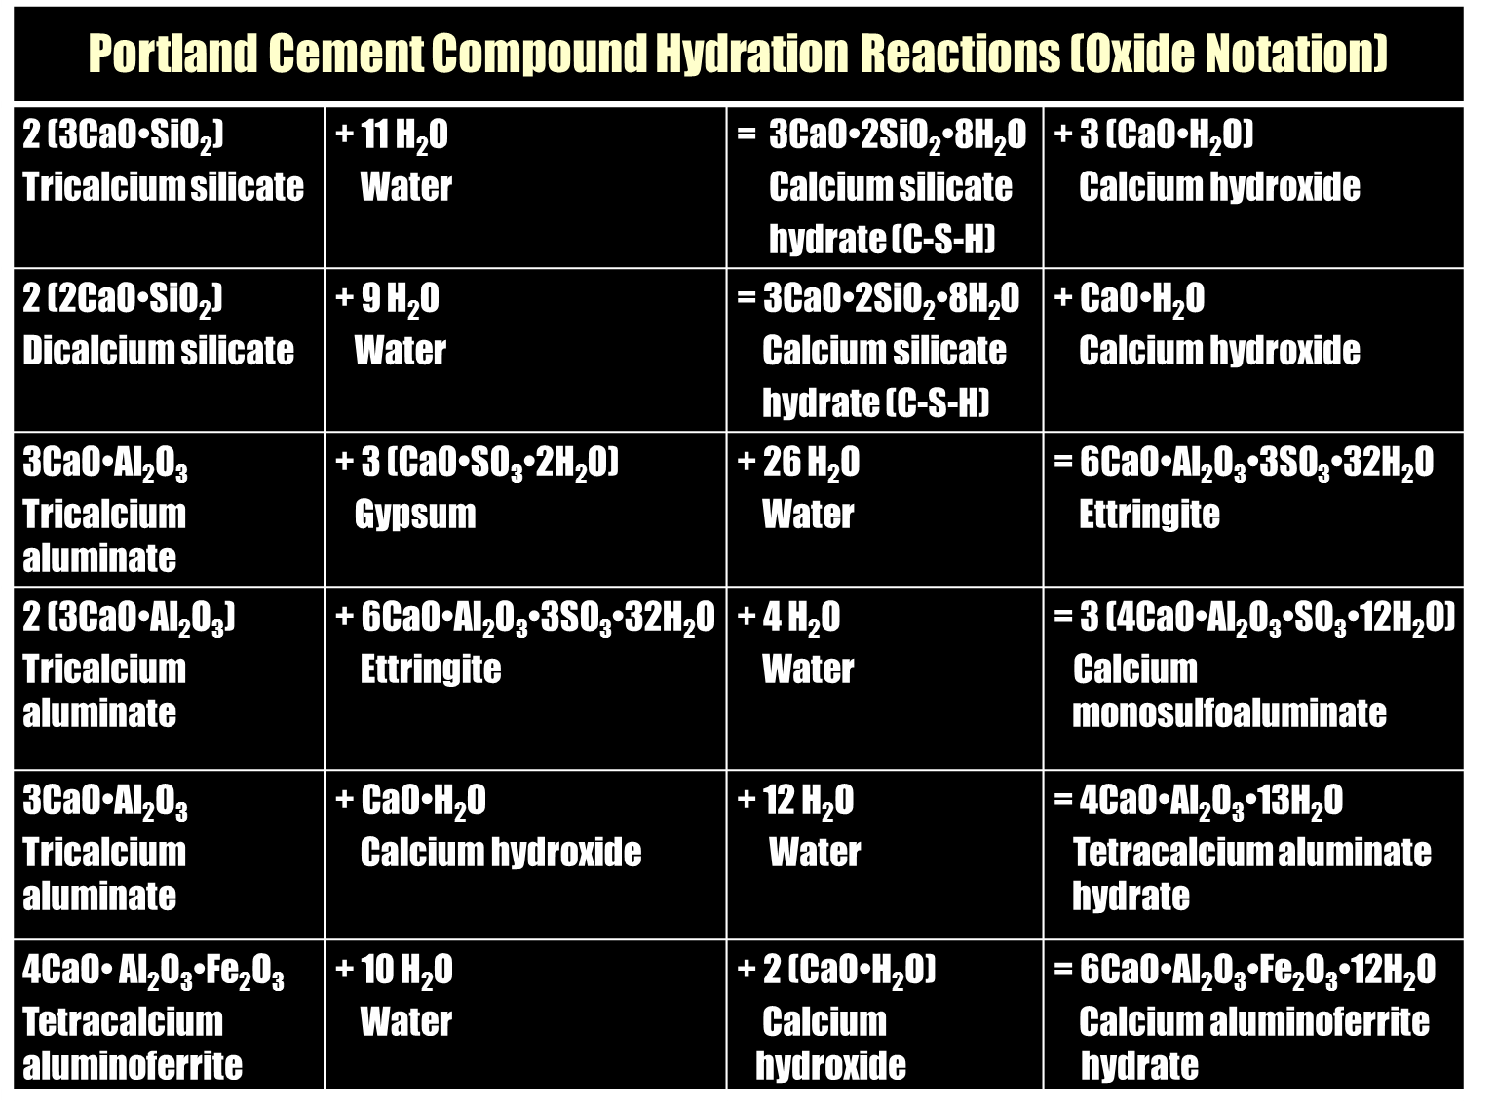

Slide 35
WET PROCESS
  Raw materials are homogenized by crushing, grinding and blending so that approximately 80%of the raw material pass a No.200 sieve.
  The mix will be turned into form of slurry by adding 30 - 40%of water.
  It is then heated to about 2750ºF (1510ºC) in horizontal revolving kilns (76-153m length and 3.6-4.8m in diameter).
  Natural gas, petroleum or coal are used for burning. High fuel requirement may make it uneconomical compared to dry process.

Slide 36
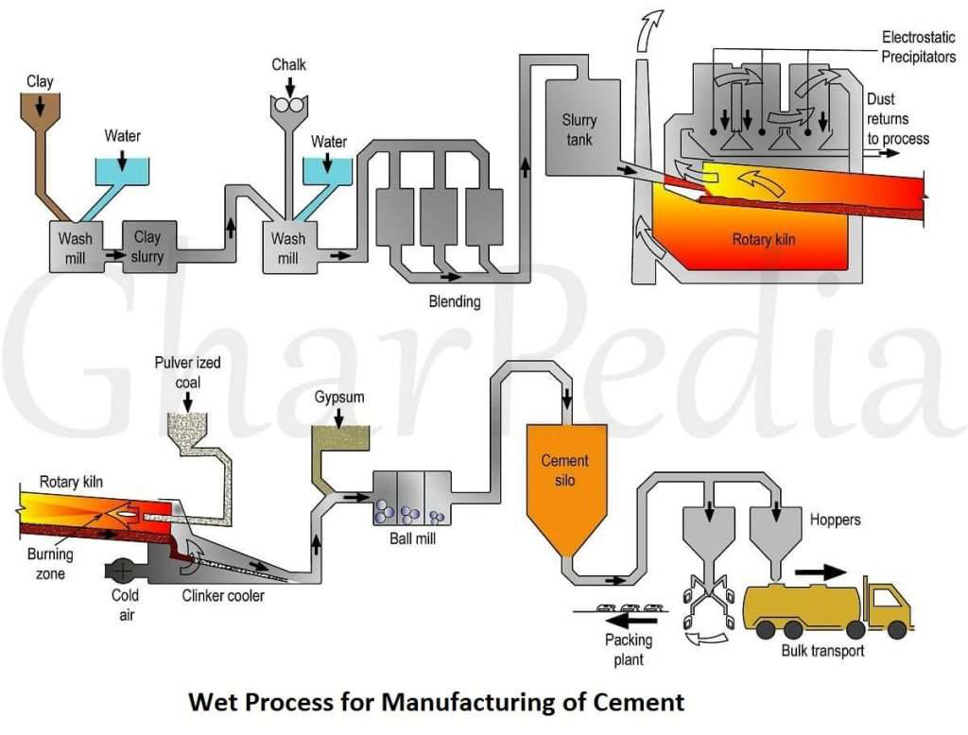

Slide 37
DRY PROCESS
  Raw materials are homogenized by crushing, grinding and blending so that approximately
  80% of the raw material pass a No.200 sieve.
  Mixture is fed into kiln & burned in a dry state
  This process provides considerable savings in fuel consumption and water usage but the process is dustier compared to wet process that is more efficient than grinding.

Slide 38
In the kiln, water from the raw material is driven off and limestone is decomposed into lime and Carbon Dioxide.
limestone = lime + Carbon Dioxide
In the burning zone, portion of the kiln, silica and alumina from the clay undergo a solid state chemical reaction with lime to produce calcium aluminate.
silica & alumina + lime = calcium aluminate

Slide 39
Burning Process
Sintering (become a coherent mass with no melting)
Fusion (complete melting)
Clinkering – only about¼ of the charge is in the liquid state
Kiln
    Long steel pipe
    Lined with refractory brick
    Inclined a few degrees
    Rotated at 60 to 200 rev/h
    Typically 6m (20 ft) in diameter and 180m (600 ft) long
  Time in the kiln from2 h (wet process) to 1 h (dry process) or even (20 min)
  modern heat exchangers

Slide 40
  Four processes take place in the kiln: Evaporation 240 to 450°C
Calcination 600 to 1100°C
  Clay decomposes (600°C)
  Limestone decomposes (700°C) – CO2 driven off
  Formation of initial compounds (1000°C)
  Initial formation of C2S (1200°C), formation of calcium aluminates and Ferrites
  Formation ofmelt (flux compoundsmelt) (1350°C)
Clinkering – charge temperature is 1400 to 1600°C
  Formation of C3S
Cooling
  Rate of cooling significantly affects the reactivity of the final cement
Klinker

Slide 41
The rotation and shape of kiln allow the blend to flow down the kiln, submitting it to gradually increasing temperature.
As the material moves through hotter regions in the kiln, calcium silicates are formed
These products, that are black or greenish black in color are in the form of small pellets, called cement clinkers
Cement clinkers are hard, irregular and ball shaped particles about 18mm in diameter.

Slide 42
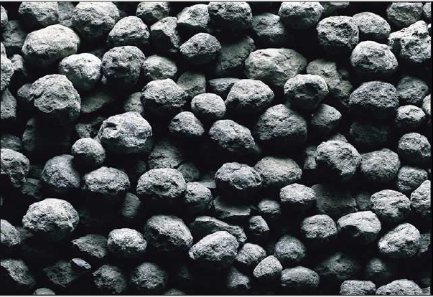
CLINKERS

Slide 43
The cement clinkers are cooled to about 150ºF (51ºC) and stored in clinker silos.
When needed, clinker are mixed with 2-5% gypsum to retard the setting time of cement when it is mixed with water.
Then, it is grounded to a fine powder and then the cement is stored in storage bins or cement silos or bagged.
Cement bags should be stored on pallets in a dry place

Slide 44
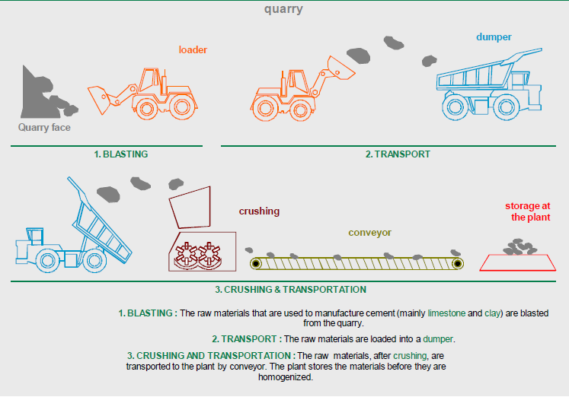

Slide 45
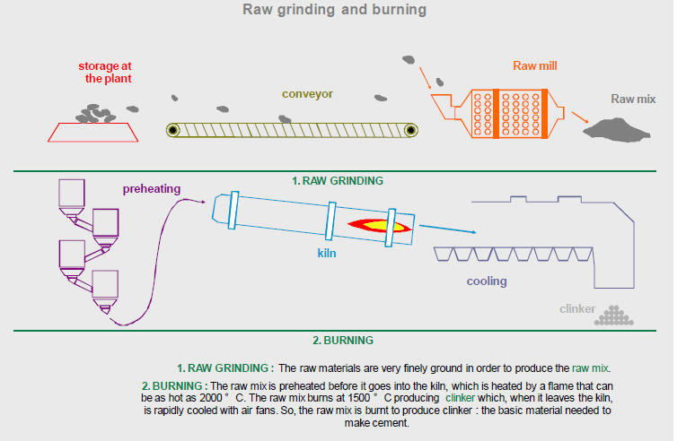

Slide 46
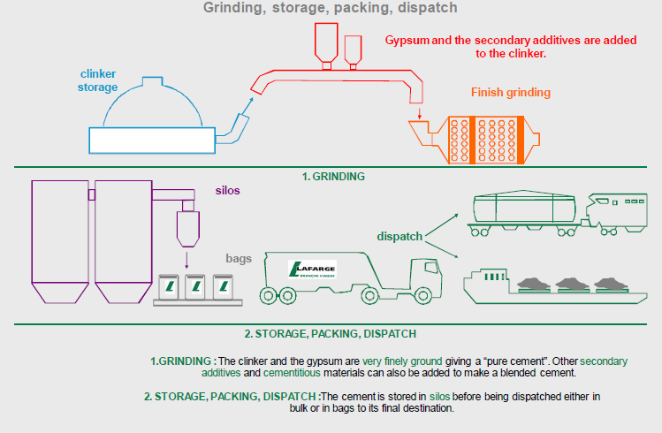

Slide 47
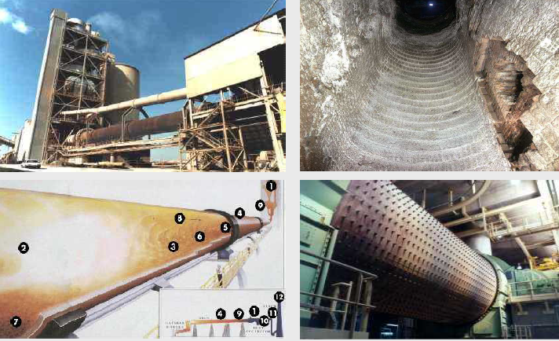

Slide 48
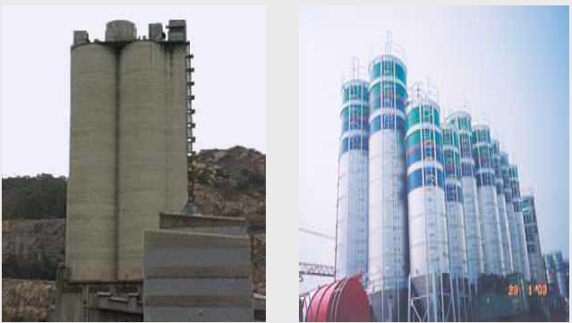

Slide 49
Cement Properties
Fineness
95% of cement particles are smaller than 45 micrometer with the average particle around 15 micrometer.
Fineness of cement affects heat released and the rate of hydration.
More is the fineness of cement more will be the rate of hydration.
Thus the fineness accelerates strength development principally during the first seven days.
Fineness tests indirectly measures the surface area of the cement particles per unit mass :
  Wagner turbidiy meter test: (ASTM C 115)
  Blaine air-permeability test (ASTM C 204)
  Sieving using No. 325 (45 μ m) sieve (ASTM C 430)

Slide 50
Soundness
Soundness is the ability of a hardened paste to retain its volume after setting.
A cement is said to be unsound (i.e. having lack of soundness) if it is subjected to delayed destructive expansion.
Unsoundness of cement is due to presence of excessive amount of hard-burned free lime or magnesia
Unsoundness of a cement is determined by the following tests:
  Le-Chatelier accelerated test (BS 4550: Part 3)
  Autoclave-expansion test (ASTM C 151)

Slide 51
Consistency
Consistency refers to the relative mobility of a freshly mixed cement paste or mortar or its abilityto flow.
Normal or Standard consistency of cement is determined using the Vicat’s Apparatus.
It is defined as that percentage of water added to form the paste which allows a penetration of 10 ± 1 mm of the Vicat plunger.

Slide 52
Setting Time
This is the term used to describe the stiffening of the cement paste.
Setting time is to determine if a cement sets according to the time limits specified in ASTM C 150.
Setting time is determined using either the Vicat apparatus(ASTM C 191) or a Gillmore needle (ASTM C 266).
“Initial setting time” is the time from the instant at which water is added to the cement until the paste ceases to be fluid and plastic which corresponds to the time at which the Vicat’s initial set needle penetrate to a point 5 mm from the bottom of a special mould.

Slide 53
ASTM C 150 prescribes a minimum initial setting time of 60minutes for Portland cements.
“Final setting time” the time required for the paste to acquire certain degree of hardness. This corresponds to the time at which the Viact’s final set needle makes an impression on the paste surface but the cutting edge fails to do so.
ASTM C 150 prescribes a maximum final setting time of 10 hours for Portland cements.
Gypsum in the cement regulates setting time. Setting time is also affected by cement fineness, w/c ratio, and admixtures.

Slide 54
Compressive Strength
Compressive strength of cement is the most important property.
It is determined by ducting compression tests on standard 50 mm mortar cubes in accordance with ASTM C 109.
In general, cement strength (based on mortar-cube tests) can not be used to predict concrete compressive strength with great degree of accuracy because of many variables in aggregate characteristics, concrete mixtures, construction procedures, and environmental conditions in the field.
Rates of compressive strength development for concrete, made with various types of cement, are shown in Fig. 2-42.

Slide 55
Heat of Hydration
It is the quantity of heat (in joules) per gram of un hydrated cement evolved upon complete hydration at a given temperature.
The heat of hydration can be determined by ASTM C
186 or by a conduction calorimeter.
The temperature at which hydration occurs greatly affects the rate of heat development.
Fineness of cement also affects the rate of heat development but not the total amount of heat liberated.

Slide 56
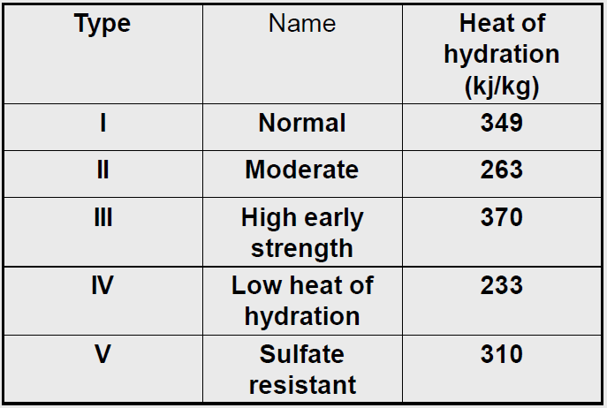
The amount of heat generated depends upon the chemical composition of cement. Following are the heat of hydration generated on hydration of the four compounds of cement.
Compound Heat of hydration Remarks C3S 502 j/g--C2S , 260 j/gMinimumC3A 867 j/gMaximumC4AF 419 j/g--C3S and C3A are the compounds responsible for the high heat evolution.
The approximate amount of heat
generated using ASTM C 186,
during the first 7 days (based on
limited data) are as follows:

Slide 57
Loss on Ignition (LOI)
  The test for loss on ignition is performed in accordance with ASTM C 114.
A high weight loss on ignition of a cement sample (between 900 to 1000ºC) is an indication of pre-hydration and carbonation, which may be caused by:
  Improper and prolonged storage
  Adulteration during transport and transfer
Loss on ignition values range between 0 to 3%

Slide 58
Density and Specific Gravity (ASTM C 188)
Density is the mass of a unit volume of the solids or particles, excluding air between particles. The particle density of Portland cement ranges from 3.10 to 3.25 Mg/m3, averaging3.15Mg/ m3.
It is used in concrete mixture proportioning calculations.
For mixture proportioning, it may be more useful to express the density as relative density (specific gravity).
On an average the specific gravity of cement is 3.15.

Slide 59
Storage of cement
Cement is moisture-sensitive material; if kept dry it will retain its quality indefinitely.
When exposed to moisture, cement will set more slowly and will have less strength compared to cement that kept dray.
At the time of use cement should be free flowing and free of lumps.

Slide 60
Setting of Cement
When water is mixed with cement, a smooth paste is produced that remains plastic for a short time. During this period, the paste can be disturbed and remixed without injury.
As the reaction between water and cement continues, the plasticity of the cement paste is lost. This early period in the hardening of cement is known as ‘Setting of Cement’.

Slide 61
Stages of Setting of Cement
The setting process of cement starts as it is mixed with water. The chemical phenomenon that takes place are divided into 3 stages,
Hydrolysis and Hydration Stage
Colloidisation Stage
Crystallisation Stage

Slide 62
Hydrolysis and Hydration Stage:
The process of setting starts after the addition of water. In this process the four compounds of cement (C₃S, C₂S, 3CA1, 4CAFe) get hydrated. C₃S compound of cement gets hydrated and form a complex hydro silicates.
Colloidization Stage:
The products formed from the above stage separates out in the form of a gel which gets gradually thickened and acts as glue around aggregates. Thereby initiating the setting of the cement. During this stage, the mortar (cement-water-sand paste) becomes fully saturated and can take no more water.

Slide 63
Crystallization Stage:
As the name of the stage indicates, most of the components of gel or colloidal state forms into crystalline state.
Compounds which are least stable such as tri-calcium hydro aluminate and calcium hydroxide are the one to undergo onto stable crystalline phase.
Calcium hydro-silicate gel also hardens almost simultaneously.
This nearly simultaneous development of crystals and hardening of gel results into a strong and inter-grown mass of crystals and gels.

Slide 64
Setting Time of Cement
1. Initial Setting Time
Initial Setting Time is defined as the period elapsing between the time when water is added to the cement and the time at which the needle of 1 mm square section fails to pierce the test block to a depth of about 5 mm from the bottom of the mould. A period of 30 minutes is the minimum initial setting time, specified by ISI for ordinary and rapid hardening Portland cements and 60 minutes for low heat cement.

Slide 65
2. Final Setting Time
Final Setting Time is defined as the period elapsing between the time when water is added to cement and the time at which the needle of 1 mm square section with 5 mm diameter attachment makes an impression on the test block . 600 minutes is the maximum time specified for the final set for all the above mentioned Portland cements. IS: 269-1976 specifies the strengths in compression on the standard mortar-cube.

Slide 66
Factors Affecting the Setting Time Of Cement
Many factors affect the setting time of cement after mixed with water, they are Composition of cement.
Amount of gypsum in cement
Fineness of cement
Curing
Water cement ratio
Type of admixture used
Storage of cement

Slide 67
Initial and Final Setting time of different type of cement.
Type/Name of Cement | Initial Setting Time in min | Final Setting Time in min
OPC(33) | 30 | 600
OPC(43) | 30 | 600
OPC(53) | 30 | 600
Sulphate Resisting cement | 30 | 600
Portland Pozzolana Cement | 30 | 600
Rapid hardening cement | 30 | 600
Portland Slag Cement | 30 | 600
High alumina | 30 | 600
Super sulphated | 30 | 600
Low heat | 60 | 600
Masonry cement | 90 | 1440

Slide 68
Reactions in setting of Cement
Setting is defined as stiffening of the original plastic mass due to initial gel formation. Hardening is development of strength due to crystallization.
After setting, hardening starts due to the gradual process of crystallization in the interior of the mass. The strength developed by cement paste at any time, depends upon the amount of gel formed and the extend of crystallization.

Slide 69
Initial setting of cement paste is mainly due to the hydration of tricalcium aluminate (C3A) and gel formation of tetracalcium.
3CaOAl₂O₃ + 6H₂O → CaOAl₂O₃.6H₂0 + 880KJ/kg
Tricalcium aluminate hydrated tricalcium alumionate
4CaO.Al₂O₃.Fe₂O₃ +H₂O →3CaO.Al₂O₃.6H₂O + CaO.Fe₂O₃.H₂O + 420KJ/kg
Dicalcium silicate starts hydrolyzing to tabermonite gel (which Possesses a very high surface area and thus, very high adhesive property) which also contributes to initial setting.
2[2CaO.SiO₂] + 4H₂O → 3CaO.SiO₂.6H₂O+Ca(OH)₂ + 250KJ/Kg

Slide 70
Dicalcium silicate Termonite gel Crystalled calcium hydroxide.
Final setting and hardening of cement paste is due to the formation of termoite gel plus crystallization of calcium hydroxide and hydrated tricalcium aluminate.
2[2CaO.SiO₂] +6H₂O → 3CaO.2SiO₂.3H₂O + Ca(OH)₂ + 500KJ/kg
When water is added to cement, at first hydration of C3A and C4AF takes place within day.
C3S begins to crystallise within 24 hrs snd gets completed in 7 days.
The gel of aluminate begins to crystallise and at the same time C2S begins to hydrate in 7 – 28 days.
The development of early strength between 1-7 days is due to the hydration of C3S and further hydration of aluminate
The increase of strength between 7-28 days, is due to hydration of C2S and continued hydration of C3S.

Slide 71
CERAMICS
A ceramic is any of the various hard, brittle, heat-resistant and corrosion-resistant materials made by shaping and then firing an inorganic, nonmetallic material, such as clay, at a high temperature.
A ceramic is an inorganic non-metallic solid made up of either metal or non-metal compounds that have been shaped and then hardened by heating to high temperatures. In general, they are hard, corrosion-resistant and brittle.
Common examples are earthenware, porcelain, and brick. space shuttles, appliances (enamel coatings), and airplanes
Ceramics are all around us.

Slide 72
Properties of Ceramics
The properties of ceramic materials, like all materials, are dictated by the types of atoms present, the types of bonding between the atoms, and the way the atoms are packed together.
Hard,
Wear-resistant,
Brittle,
Refractory,
Thermal insulators,
Electrical insulators,
Nonmagnetic,
Oxidation resistant,
Prone to thermal shock,
Chemically stable.

Slide 73
The atoms in ceramic materials are held together by a chemical bond. The two most common chemical bonds for ceramic materials are covalent and ionic.
For metals, the chemical bond is called the metallic bond. The bonding of atoms together is much stronger in covalent and ionic bonding than in metallic.
That is why, generally speaking, metals are ductile and ceramics are brittle.
Due to ceramic materials wide range of properties, they are used for a multitude of applications.

Slide 75
RAW MATERIAL
Bentonite
Kaolin
White sand
limestone

Slide 76
Function of raw materials
Clay
Produces a light colouring during firing
Gives plasticity and binding characteristics to the mass
Enhances mechanical characteristic in the fired tiles
Produces good flow properties
Gives a good density level during firing due to the individual characteristic of the clays.

Slide 77
Feldspar
Feldspars play an important role in achieving the vitreous nature of the body and the high mechanical resistance of the product at the end of the firing stage.
Acting as a flux, feldspars also facilitate drying
and release of gas during firing like other non-plastics.

Slide 78
Silica
Facilitate escape of gases during drying and
firing.
Reduces drying shrinkage and increases the
whiteness of the fired body.
Talc
Used in small quantities (2-6%) in the vitrified tile body composition to enhance the fluxing action of felds-pathic materials.

Slide 79
Refractories
Refractories are inorganic, nonmetallic, porous and heterogeneous materials composed of thermally stable mineral aggregates, a binder phase and additives.
Non-metallic materials having those chemical and physical properties that make them applicable for structures or as components of systems that are exposed to environments above 538 deg C’.
The basic raw material is the oxides of silicon, aluminum, magnesium, calcium and zirconium.
Refractories are chosen according to the conditions they face during their use.

Slide 80
Refractories are the materials that can
Withstand high temperatures and sudden changes
Withstand action of molten slag, glass, hot gases etc (thermal stress and strain).
Withstand against the corrosion/erosion.
Withstand load at service conditions
Withstand abrasive forces (to different degrees of mechanical stress and strain).
Conserve heat
Have low coefficient of thermal expansion
Will not contaminate the load

Slide 81
Functions of Refractories
Acting as a thermal barrier between a hot medium (e.g., flue gases, liquid metal, liquid slags, and molten salts) and the wall of the containing vessel.
Insuring a strong physical protection, preventing the erosion of walls by the circulating hot medium
Representing a chemical protective barrier against corrosion, and
Acting as thermal insulation, insuring heat retention.

Slide 82
Classification of Refractories
Chemical composition,
Chemical properties of their constituent substances
By the place of use
The refractoriness
Method of manufacture
Physical form
According to the applications
Based on thermal conductivity
According to the principal base features
Based on compactness.

Slide 83
Classification based on chemical composition
Silica refractories
Fireclay refractories
Alumina refractories
Magnesia refractories
Dolomite refractories
Magnesia-chrome or chrome-magnesite refractories
Silicon carbide refractories
Zirconia refractories
Carbon refractories

Slide 84
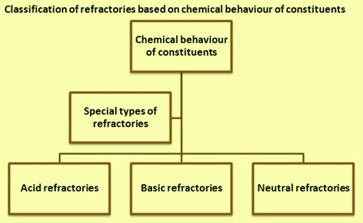

Slide 85
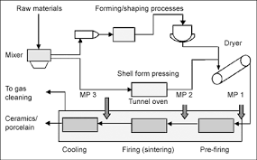

Slide 86
1) Acid Refractory: This refractories are made up of acidic material like zircon, fire clay and silica.
2) Basic Refractories: This type is made up of basic material like dolomite, magnetia.
3) Neutral Refractory: Thus type is made up of alumina, chromite, silicon carbide and mulite. we can not use acidic refractory directly in the basic environment and vice versa because they will be corroded.

Slide 87
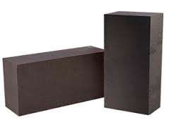
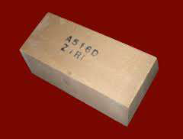
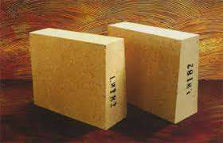
Classification on basis of temperature range
Refractory: when temperature is between 1580-1780 e.g. fire clay
High Refractory: when temperature is between 1780-2000 E.g. chromites
Super refractory: when temperature is between >2000 E.g. zircons
Fire Clay Brics Chromite Bricks Zirconia Brics

