Slide 1

KINEMATICS OF MACHINES (KOM)
L. E. College, Morbi-2
Industrial Engineering Department
Chapter-02–Velocity and Acceleration Analysis of Mechanisms:
Prepared by Prof. Divyesh B.Patel
Mechanical Engg. Dept
LE. College, Morbi
+919925282644
divyesh21dragon@gmail.com

Slide 2


Relative Velocity of Two Bodies
Moving in Straight Lines
Prepared by Prof. D.B.Patel
Mechanical Engg. Dept
LE. College, Morbi
Consider two bodies A and B moving along parallel lines in the same direction with absolute velocities V_{A} and V_{B} such that V_{A} > V_{B} , as shown in Fig..
The relative velocity of A with respect to B,
V_{AB}= Vector difference of V_{A} and V_{B} = V_{A} - V_{B}
V_{A}
V_{B}
V_{A}
o
b
a
V_{AB}
V_{B}
V_{BA}
The relative velocity of A with respect to B (i.e. V_{AB}) may be written in the
vector form as follows :
Similarly, the relative velocity of B with respect to A,

Slide 3
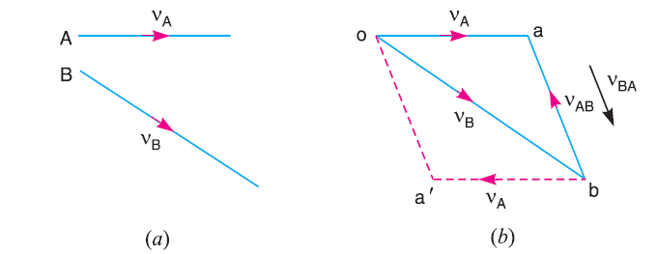

Relative Velocity of Two Bodies
Moving in Straight Lines
Prepared by Prof. D.B.Patel
Mechanical Engg. Dept
LE. College, Morbi
Now consider the body B moving in an inclined direction as shown in Fig (a).
The relative velocity of A with respect to B may be obtained by the law of parallelogram of velocities or triangle law of velocities. Take any fixed point o and draw vector oa to represent V_{A} in magnitude and direction to some suitable scale. Similarly, draw vector ob to represent V_{B} in magnitude and direction to the same scale. Then vector ba represents the relative velocity of A with respect to B as shown in Fig (b). In the similar way as discussed above, the relative velocity of A with respect to B, The relative velocity of A with respect to B,

Slide 4
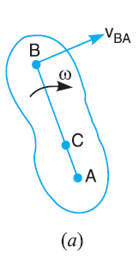
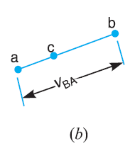
Motion of a Link
Prepared by Prof. D.B.Patel
Mechanical Engg. Dept
LE. College, Morbi
Consider two points A and B on a rigid link AB, as shown in Fig. 7.3 (a). Let one of the extremities (B) of the link move relative to A, in a clockwise direction. Since the distance from A to B remains the same, therefore there can be no relative motion between A and B, along the line AB. It is thus obvious, that the relative motion of B with respect to A must be perpendicular to AB.
Velocity of any point on a link with respect to another point on the same link is always perpendicular to the line joining these points on the configuration (or space) diagram.

Slide 5
Motion of a Link
Prepared by Prof. D.B.Patel
Mechanical Engg. Dept
LE. College, Morbi
The relative velocity of B with respect to A (i.e. V_{BA}) is represented by the vector ab and is perpendicular to the line AB as shown in Fig.
We know that the velocity of the point B with respect to A,
V_{AB} = ω AB ……..(1)
Similarly, the velocity of any point C on AB with respect to A,
V_{AC} = ω AC ……(2)
From equation (1) and (2)
V_{AB} / V_{AC} = ω AB/ ω AC → V_{AB} / V_{AC} = AB/ AC

Slide 6
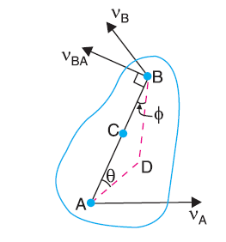
Velocity of a Point on a Link by Relative Velocity Method
b
V_{BD}
d
ϕ
V_{AB}
c
V_{D}
V_{AD}
V_{B}
V_{C}
θ
o
V_{A}
a
V_{AB} / V_{AC} =ab/ac=AB/AC
ac=ab (AC/AB)
ω_{AB}=V _{AB} /AB =ab/ AB

Slide 7
Rubbing Velocity at a Pin Joint
The links in a mechanism are mostly connected by means of pin joints. The rubbing velocity is defined as the algebraic sum between the angular velocities of the two links which are connected by pin joints, multiplied by the radius of the pin.
Consider two links OA and OB connected by a pin joint at O as shown in Fig.
ω₁
ω₂
A
B
O
ω1 = Angular velocity of the link OA or the angular velocity of the point A with respect to O.
ω 2 = Angular velocity of the link OB or the angular velocity of the point B with respect to O, and
r = Radius of the pin.
Rubbing velocity at the pin joint O
= (ω₁ – ω₂) r, if the links move in the same direction
= (ω₁ + ω₂) r, if the links move in the opposite direction

Slide 8
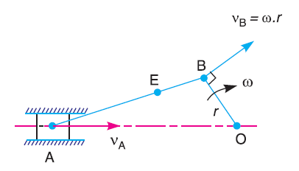
Velocities in Slider Crank Mechanism
Prepared by Prof. D.B.Patel
Mechanical Engg. Dept
LE. College, Morbi
b
V_{B} = ω r
e
V_{AB}
V_{E}
o
V_{A}
a
V_{AB} / V_{BE} =ab/be=AB/BE
be=ab (BE/AB)
ω_{AB}=V _{AB} /AB =ab/ AB

Slide 9
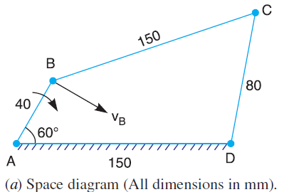
Velocities in four bar chain Mechanism
In a four bar chain ABCD, AD is fixed and is 150 mm long. The crank AB is 40 mm long and rotates at 120 r.p.m. clockwise, while the link CD = 80 mm oscillates about D. BC and AD are of equal length. Find the angular velocity of link CD when angle BAD = 60°.
N_{BA}= 120 rpm
ω_{BA} =2π N/60 = 2π 120/60 =12.57 rad/sec
v_{BA} = ω_{BA} ×AB = 12.57 × 0.04 = 0.5028 m/s
d
a
V_{AC} or V_{DC}
c
V_{CB}
V_{AB} = ω r
b
Prepared by Prof. D.B.Patel
Mechanical Engg. Dept
LE. College, Morbi

Slide 10
Thank you

