Slide 1
DATA WAREHOUSING
&
DATA MINING
Prepared by:
Anita Parmar

Slide 2
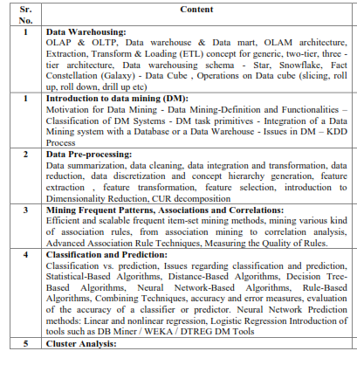
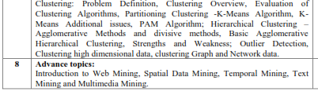

Slide 3


Slide 4
Data Mining:
Concepts and Techniques
— Chapter 2 —
Introduction to Data Mining

Slide 5
Chapter 2. Introduction
Motivation: Why data mining?
What is data mining?
Data Mining: On what kind of data?
Data mining functionality
Classification of data mining systems
Data mining task primitives
Major issues in data mining

Slide 6
Why Data Mining?
The Explosive Growth of Data: from terabytes to petabytes
  Data collection and data availability
    Automated data collection tools, database systems, Web, computerized society
  Major sources of rich data
    Business: Web, e-commerce, transactions, stocks, …
    Science: Remote sensing, bioinformatics, scientific simulation, …
    Society and everyone: news, digital cameras, YouTube
We are drowning in data, but starving for knowledge!
“Necessity is the mother of invention”—Data mining—Automated analysis of massive data sets

Slide 7
Evolution of Database Technology
1960s:
  Data collection, database creation, file creation
1970s:
  Relational data model, relational DBMS implementation
1980s:
  RDBMS, advanced data models (extended-relational, OO, deductive, etc.)
  Application-oriented DBMS (spatial, scientific, engineering, etc.)
1990s:
  Data mining, data warehousing, multimedia databases, and Web databases
2000s
  Data mining and its applications
  Web technology (XML, data integration)

Slide 8
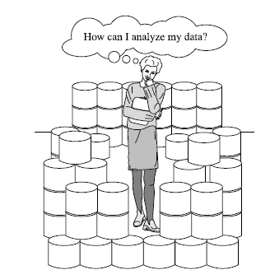
data rich but information poor

Slide 9
We want to know ...
Which types of transactions are likely to be fraudulent given the transactional history of a particular customer?
If I raise the price of my product by Rs. 2, what is the effect on my business?
If I offer only 2,500 as an incentive to purchase rather than 5,000, how many lost responses will result?
If I emphasize ease-of-use of the product as opposed to its technical capabilities, what will be the net effect on my revenues?
Which of my customers are likely to be the most loyal?
Data Mining helps extract such information

Slide 10
What Is Data Mining?
Data mining (knowledge discovery from data)
  Extraction of interesting patterns or knowledge from huge amount of data.
Alternative names
  Knowledge discovery (mining) in databases (KDD), knowledge extraction, data/pattern analysis, data dredging(searching), information harvesting(gathering), business intelligence, etc.

Slide 11
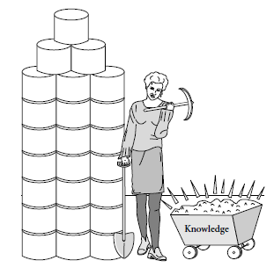

Slide 12
Knowledge Discovery from data (KDD) Process
Knowledge
  Data mining—core of knowledge discovery process
Pattern Evaluation
Data Mining
Task-relevant Data
Data Warehouse
Selection and transformation
Data Cleaning
Data Integration
Databases

Slide 13
KDD Process: Several Key Steps
1.Data cleaning : to remove noise and inconsistent data (may take 60% of effort!)
2. Data integration : Where multiple data sources may be combined.
3. Data selection :
  Where data relevant to the analysis task are retrieved from the database.
4. Data Transformation
  Where data are transformed or consolidated into forms appropriate for mining by performing summary or aggregation

Slide 14
Continue…
5. Data mining: search for patterns of interest.
  An essential process where intelligent methods are applied in order to extract data patterns.
6. Pattern evaluation: to identify the truly interesting patterns representing knowledge based on some interestingness measures
7. Knowledge presentation : visualization and knowledge representation techniques are used to present the mined knowledge to the user.

Slide 15
Data Mining and Business Intelligence
Increasing potential
to support
business decisions
End User
Decision Making
Data Presentation
Business
Analyst
Visualization Techniques
Data Mining
Data
Analyst
Information Discovery
Data Exploration
Statistical Summary, Querying, and Reporting
Data Preprocessing/Integration, Data Warehouses
Data Sources
DBA
Paper, Files, Web documents, Scientific experiments, Database Systems

Slide 16
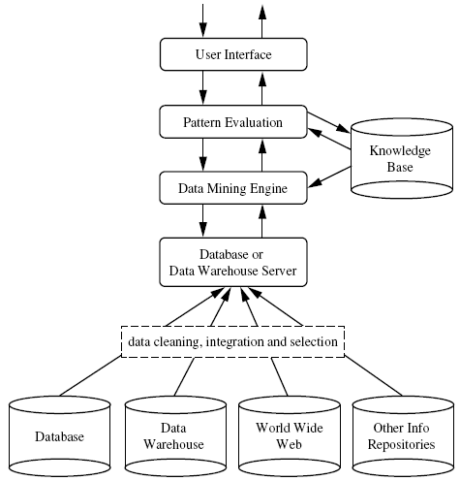
Architecture of a data mining system

Slide 17
Continue…
Database, Data warehouse, WWW or other information repository:
  A set of Database, data warehouse, spreadsheets, or other kind of information repositories.
  Data cleaning and data integration techniques may be performed on the data.
Database or data warehouse server :
  Responsible for fetching the relevant data, based on the user’s data mining request.
Knowledge base:
  Domain knowledge that is used to guide the search or evaluate the interestingness of resulting patterns. For ex.,
  Concept hierarchies, used to organize attributes or attribute values into different levels of abstraction,
  User beliefs, which can be used to assess a pattern’s interestingness based on its unexpectedness, may also be included.
  Additional interestingness constraints or thresholds and metadata.

Slide 18
Continue…
Data mining engine:
  Essential to the data mining system
  Consists of a set of functional modules.
Pattern evaluation module:
  Employs interestingness measures and interacts with the data mining modules so as to focus the search toward interesting patterns.
  It may use interestingness thresholds to filter out discovered patterns.
  In many system pattern evaluation module may be integrated with the mining module, depending on the implementation of the data mining method used.
User interface:
  Communicate between users and the data mining system.
  Allowing the user to interact with the system by specifying a data mining query or task, providing information to help focus the search,
  performing exploratory data mining based on the intermediate data mining results.
  Allows the user to browse database and data warehouse schemas or data structures,
  evaluate mined patterns,
  and visualize the patterns in different forms.

Slide 19
Data Mining: On What Kinds of Data?
Database-oriented data sets and applications
  Relational database,
  data warehouse,
  transactional database
Advanced data sets and advanced applications
  Object-relational databases
  Temporal data, sequence data (incl. bio-sequences), Time-series data
    Time related, customer shopping sequence, sequence of values repeated over time(hourly, monthly,daily)
  Spatial data and spatiotemporal data
    Geographic database, VLSI data, satellite images etc.

Slide 20
Data Mining: On What Kinds of Data?
  Heterogeneous databases and legacy databases
    Ex. Information of students performance at different schools
  Data streams
  Multimedia database
  Text databases
  The World-Wide Web

Slide 21
Data Mining Functionalities : what kinds of patterns can be mined
Concept description: Characterization and discrimination
  Generalize, summarize, and contrast data characteristics,
  Eg. Find characteristics of Customers who spend more than 10,000 per month
  Eg. Compare customers who shop regularly verses who shop rarely
Frequent patterns, association, correlation
  computer → printer [0.5%, 75%]
Classification and prediction
  Construct models (functions) that describe and distinguish classes or concepts for future prediction
    E.g., classify countries based on (climate), or classify cars based on (gas mileage)
  Predict some unknown or missing numerical values

Slide 22
Data Mining Functionalities (2)
Cluster analysis
  Class label is unknown: Group data to form new classes, e.g., cluster houses to find distribution patterns
  Maximizing intra-class similarity & minimizing interclass similarity
Outlier analysis
  Outlier: Data object that does not comply with the general behavior of the data
  Noise or exception? Useful in fraud detection, rare events analysis
Trend and evolution analysis
  Regularities or trends for object whose behavior changes over time.
  Ex. Stock exchange

Slide 23
Are All the “Discovered” Patterns Interesting?
Data mining may generate thousands of patterns: Not all of them are interesting
Interestingness measures
  A pattern is interesting if it is easily understood by humans, valid on new or test data with some degree of certainty, potentially useful, novel, or validates some hypothesis that a user seeks to confirm
Objective vs. subjective interestingness measures
  Objective: based on statistics and structures of patterns, e.g., support, confidence, etc.
  Subjective: based on user’s belief in the data

Slide 24
Find All and Only Interesting Patterns?
Find all the interesting patterns: Completeness
  Can a data mining system find all the interesting patterns? Do we need to find all of the interesting patterns?
  Association vs. classification vs. clustering
Search for only interesting patterns: An optimization problem
  Can a data mining system find only the interesting patterns?
  Approaches
    First general all the patterns and then filter out the uninteresting ones
    Generate only the interesting patterns—mining query optimization

Slide 25
Classification of Data Mining System
Database
Technology
Statistics
Machine
Learning
Data Mining
Visualization
Pattern
Recognition
Other
Disciplines
Algorithm

Slide 26
Classification of Data Mining System
Kinds of Databases to be mined
  Relational, data warehouse, transactional, stream, object-oriented/relational, spatial, time-series, text, multi-media, heterogeneous, legacy, WWW
Kinds of Knowledge to be mined
  Characterization, discrimination, association, classification, clustering, trend/deviation, outlier analysis, etc.
  Multiple/integrated functions and mining at multiple levels
Kinds of Techniques utilized
  Database-oriented, data warehouse (OLAP), machine learning, statistics, visualization, etc.
Applications adapted
  Retail, telecommunication, banking, fraud analysis, bio-data mining, stock market analysis, text mining, Web mining, etc.

Slide 27
Primitives that Define a Data Mining Task
Task-relevant data
  Database or data warehouse name
  Database tables or data warehouse cubes
  Condition for data selection
  Relevant attributes or dimensions
  Data grouping criteria
Type of knowledge to be mined
  Characterization, discrimination, association, classification, prediction, clustering, outlier analysis, other data mining tasks
Background knowledge
Pattern interestingness measurements
Visualization/presentation of discovered patterns

Slide 28
Primitive 3: Background Knowledge
A typical kind of background knowledge: Concept hierarchies
Schema hierarchy
  E.g., street < city < province_or_state < country
Set-grouping hierarchy
  E.g., {20-39} = young, {40-59} = middle_aged
Operation-derived hierarchy
  email address: hagonzal@cs.uiuc.edu
    login-name < department < university < country
Rule-based hierarchy
  low_profit_margin (X) <= price(X, P₁) and cost (X, P₂) and (P₁ - P₂) < $50

Slide 29
Integration of Data Mining and Data Warehousing
Data mining systems, DBMS, Data warehouse systems coupling
  No coupling, loose-coupling, semi-tight-coupling, tight-coupling

Slide 30
Coupling Data Mining with DB/DW Systems
No coupling—flat file processing, not recommended
Loose coupling
  Fetching data from DB/DW
Semi-tight coupling—enhanced DM performance
  Provide efficient implement a few data mining primitives in a DB/DW system, e.g., sorting, indexing, aggregation, histogram analysis, multiway join, precomputation of some stat functions
Tight coupling—A uniform information processing environment
  DM is smoothly integrated into a DB/DW system, mining query is optimized based on mining query, indexing, query processing methods, etc.

Slide 31
Major Issues in Data Mining
Mining methodology
  Mining different kinds of knowledge from diverse data types, e.g., bio, stream, Web
  Performance: efficiency, effectiveness, and scalability
  Pattern evaluation: the interestingness problem
  Incorporation of background knowledge
  Handling noise and incomplete data
  Parallel, distributed and incremental mining methods
  Integration of the discovered knowledge with existing one: knowledge fusion
User interaction
  Data mining query languages and ad-hoc mining
  Expression and visualization of data mining results
  Interactive mining of knowledge at multiple levels of abstraction

Slide 32
Summary
Data mining: Discovering interesting patterns from large amounts of data
A natural evolution of database technology, in great demand, with wide applications
A KDD process includes data cleaning, data integration, data selection, transformation, data mining, pattern evaluation, and knowledge presentation
Mining can be performed in a variety of information repositories
Data mining functionalities: characterization, discrimination, association, classification, clustering, outlier and trend analysis, etc.
Data mining systems and architectures
Major issues in data mining

