Slide 1
Data Mining:
Concepts and Techniques
— Chapter 3 —
Data Warehouse and OLAP Technology: An Overview

Slide 2
Chapter 3: Data Warehousing and OLAP Technology: An Overview
What is a data warehouse?
A multi-dimensional data model
Data warehouse architecture
From data warehousing to data mining

Slide 3
What is Data Warehouse?
Defined in many different ways, but not rigorously (carefully).
  A decision support database that is maintained separately from the organization’s operational database
  Support information processing by providing a solid platform of consolidated, historical data for analysis.
Definition:
  “A data warehouse is a subject-oriented, integrated, time-variant, and nonvolatile collection of data in support of management’s decision-making process.”—W. H. Inmon
Data warehousing:
  Is the process of constructing and using data warehouses

Slide 4
Data Warehouse—Subject-Oriented
Organized around major subjects, such as customer, product, sales.
Focusing on the modeling and analysis of data for decision makers, not on daily operations or transaction processing.
Provide a simple and concise view around particular subject issues by excluding data that are not useful in the decision support process.

Slide 5
Data Warehouse—Integrated
Constructed by integrating multiple, heterogeneous data sources
  relational databases, flat files, on-line transaction records
Data cleaning and data integration techniques are applied.
  To ensure consistency in naming conventions, encoding structures, attribute measures, etc. among different data sources
    E.g., Hotel price: currency, tax, breakfast covered, etc.
  When data is moved to the warehouse, it is converted.

Slide 6
Data Warehouse—Time Variant
The time horizon for the data warehouse is significantly longer than that of operational systems
  Operational database: current value data
  Data warehouse data: provide information from a historical perspective (e.g., past 5-10 years)
Every key structure in the data warehouse
  Contains an element of time, explicitly or implicitly
  But the key of operational data may or may not contain “time element”

Slide 7
Data Warehouse—Nonvolatile
A physically separate store of data transformed from the operational environment
Operational update of data does not occur in the data warehouse environment
  Does not require transaction processing, recovery, and concurrency control mechanisms
  Requires only two operations in data accessing:
    initial loading of data and access of data

Slide 8
Construction of data warehouse requires data cleaning, integration and consolidation.
Organization use this information to decision making.
  Ex. Increasing customer focus(analyzing buying patterns), comparing performance of sales by years or by geographic regions, etc.

Slide 9
Data Warehouse vs. Operational DBMS
OLTP (on-line transaction processing)
  Major task of traditional relational DBMS
  Day-to-day operations: purchasing, inventory, banking, manufacturing, payroll, registration, accounting, etc.
OLAP (on-line analytical processing)
  Major task of data warehouse system
  Data analysis and decision making
Distinct features (OLTP vs. OLAP):
  User and system orientation: customer vs. market
  Data contents: current, detailed vs. historical, consolidated
  Database design: ER + application vs. star + subject
  View: current, local vs. evolutionary, integrated
  Access patterns: update vs. read-only but complex queries

Slide 10
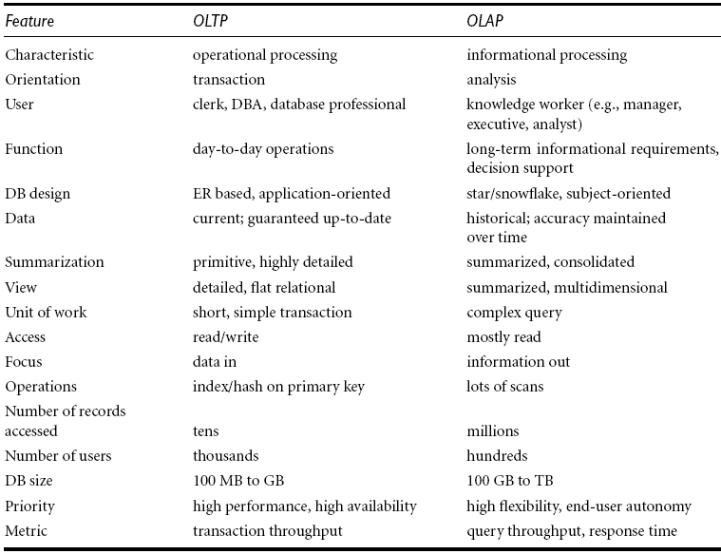

Slide 11
Why Separate Data Warehouse?
High performance for both systems
  DBMS— tuned for OLTP: access methods, indexing, concurrency control, recovery
  Warehouse—tuned for OLAP: complex OLAP queries, multidimensional view, consolidation
Different functions and different data:
  missing data: Decision support requires historical data which operational DBs do not typically maintain
  data consolidation: DS requires consolidation (aggregation, summarization) of data from heterogeneous sources
  data quality: different sources typically use inconsistent data representations, codes and formats which have to be reconciled

Slide 12
Chapter 3: Data Warehousing and OLAP Technology: An Overview
What is a data warehouse?
A multi-dimensional data model
Data warehouse architecture
From data warehousing to data mining

Slide 13
From Tables and Spreadsheets to Data Cubes
A data warehouse is based on a multidimensional data model which views data in the form of a data cube.
Data cube allows data to be modeled and viewed in multiple dimensions. It is defined by dimensions and facts.
Dimensions: are the perspectives or entities with respect to which an organization wants to keep records.
For example: AllElectronics may create a sales data warehouse in order to keep records of the store’s sales with respect to the dimension “time”, “item”, “branch”, and “location”.
Each dimension may have a table associated with it called dimension table, which further describes the dimension.
For ex dimension table for item may contain the attributes item_name, brand and type.

Slide 14
Data Cubes
A multidimensional data model is typically organized around a central theme, for ex. Sales.
This theme is represented by a fact table.
Facts are numerical measures. A quantities by which we want to analyze relationships between dimensions.
For ex. Facts for a sales data warehouse include dollars_sold(sales amount in dollars), unit_sold(no of unit sold)
Fact table contains the names of the facts, or measures as well as keys to each of the related dimension tables.

Slide 15
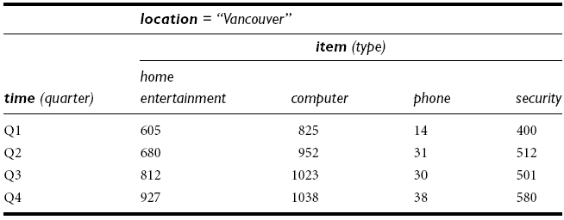
Data Cubes
2-D data cube: a table or spreadsheet for sales data from Allelectronics.
Sales data for items sold per quarter in city of vancouver.
2-D representation, the sales for Vancouver, with respect to the time dimension and item dimension(type of item sold)

Slide 16
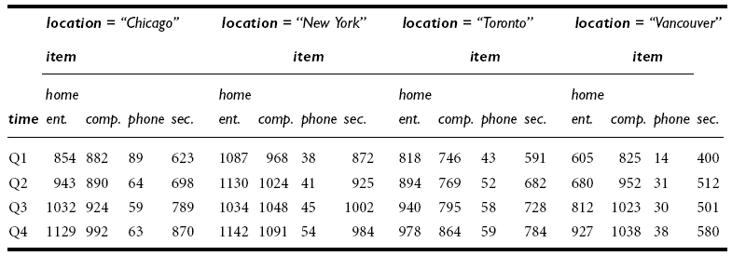
Data Cubes
3-D data cube : view the data according to time and item, as well as location for the cities “chicago”, “new york”, “toronto” and “vancourer”.

Slide 17
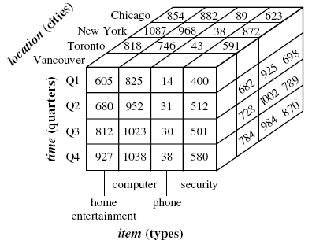

Slide 18
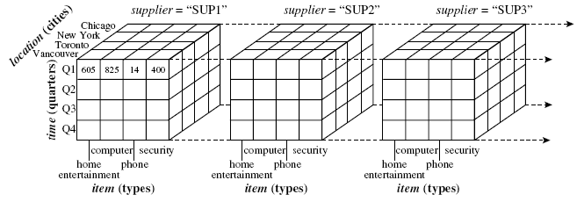
Data Cubes
4-D data cube: view data according to time, item type, location as well as supplier.
4-D cube can be represented as the series of 3-D cube.

Slide 19
Cube: A Lattice of Cuboids
all
0-D(apex) cuboid
time
item
location
supplier
1-D cuboids
time,location
item,location
location,supplier
time,item
2-D cuboids
time,supplier
item,supplier
time,location,supplier
3-D cuboids
time,item,location
time,item,supplier
item,location,supplier
4-D(base) cuboid
time, item, location, supplier

Slide 20
Data Cubes
Data cube are often referred to as a cuboid.
For set of dimensions, we can generate a cuboid for each of the possible subsets of the given dimensions.
Result would form a lattice of cuboids.
The lattice of cuboids is then referred to as a data cube.
The lowest level of summarization is called the base cuboid.
The highest level of summarization is called the apex cuboid.
The apex cuboid is typically denoted by all.

Slide 21
Schemas for multidimensional Databases
Star Schema: The most common paradigm.
  Data warehouse contains:-
    1) A large central table (fact table) containing the bulk of the data, with no redundancy,
    2) A set of smaller attendant tables(dimension tables), one for each dimension.

Slide 22
Example of Star Schema
time
time_key
day
day_of_the_week
month
quarter
year
item
item_key
item_name
brand
type
supplier_type
Sales Fact Table
time_key
item_key
branch_key
branch
location
location_key
branch_key
branch_name
branch_type
location_key
street
city
state_or_province
country
units_sold
dollars_sold
avg_sales
Measures

Slide 23
Schemas for multidimensional Databases
Snowflake Schema: Variant of the star schema model.
  Some dimension tables are normalized, thereby further splitting the data into additional tables.
  Resulting schema graph forms a shape similar to a snowflake.
  Snowflake structure can reduce the effectiveness of browsing, since more joins will be needed to execute a query.
  So, the system performance may be effected.

Slide 24
Example of Snowflake Schema
time
item
time_key
day
day_of_the_week
month
quarter
year
item_key
item_name
brand
type
supplier_key
supplier
Sales Fact Table
supplier_key
supplier_type
time_key
item_key
branch_key
branch
location
location_key
location_key
street
city_key
branch_key
branch_name
branch_type
units_sold
dollars_sold
city
city_key
city
state_or_province
country
avg_sales
Measures

Slide 25
Schemas for multidimensional Databases
Fact constellation:
  Sophisticated applications may require multiple fact tables to share dimension tables.
  Schema can be viewed as a collection of stars, hence is called a galaxy schema or a fact constellation.

Slide 26
Example of Fact Constellation
time
time_key
day
day_of_the_week
month
quarter
year
item
Shipping Fact Table
item_key
item_name
brand
type
supplier_type
Sales Fact Table
time_key
time_key
item_key
shipper_key
item_key
branch_key
from_location
branch
location_key
location
to_location
branch_key
branch_name
branch_type
units_sold
location_key
street
city
province_or_state
country
dollars_cost
dollars_sold
units_shipped
avg_sales
shipper
Measures
shipper_key
shipper_name
location_key
shipper_type

Slide 27
Data mart
A data warehouse collects information abut subjects that span the entire organization, such as customers, items, sales, assets, and personnel, and thus its scope is enterprise-wide.
so for data warehouses, the fact constellation schema is commonly used.
A data mart, on the other hand is a department subset of the data warehouse that focuses on selected subjects, and thus its scope is department-wide.
For data mart star or snowflake schema is used.

Slide 28
Defining Star, Snowflake, Fact constellation schemas
A Data mining query language can be used to specify data mining tasks.
Data warehouses and data marts can be defined using two language primitives :
  Cube definition.
  define cube <cube_name> [<dimension_list>]: <measure_list>
  Dimension definition.
  define dimension <dimension_name> as <attribute_or_dimension_list>)

Slide 29
Cube Definition Syntax (BNF) in DMQL
Cube Definition (Fact Table)
  define cube <cube_name> [<dimension_list>]: <measure_list>
Dimension Definition (Dimension Table)
  define dimension <dimension_name> as (<attribute_or_subdimension_list>)
Special Case (Shared Dimension Tables)
  First time as “cube definition”
  define dimension <dimension_name> as <dimension_name_first_time> in cube <cube_name_first_time>

Slide 30
Defining Star Schema in DMQL
define cube sales_star [time, item, branch, location]:
    dollars_sold = sum(sales_in_dollars), avg_sales = avg(sales_in_dollars), units_sold = count(*)
define dimension time as (time_key, day, day_of_week, month, quarter, year)
define dimension item as (item_key, item_name, brand, type, supplier_type)
define dimension branch as (branch_key, branch_name, branch_type)
define dimension location as (location_key, street, city, province_or_state, country)

Slide 31
Defining Snowflake Schema in DMQL
define cube sales_snowflake [time, item, branch, location]:
    dollars_sold = sum(sales_in_dollars), avg_sales = avg(sales_in_dollars), units_sold = count(*)
define dimension time as (time_key, day, day_of_week, month, quarter, year)
define dimension item as (item_key, item_name, brand, type, supplier(supplier_key, supplier_type))
define dimension branch as (branch_key, branch_name, branch_type)
define dimension location as (location_key, street, city(city_key, province_or_state, country))

Slide 32
Defining Fact Constellation in DMQL
define cube sales [time, item, branch, location]:
    dollars_sold = sum(sales_in_dollars), avg_sales = avg(sales_in_dollars), units_sold = count(*)
define dimension time as (time_key, day, day_of_week, month, quarter, year)
define dimension item as (item_key, item_name, brand, type, supplier_type)
define dimension branch as (branch_key, branch_name, branch_type)
define dimension location as (location_key, street, city, province_or_state, country)
define cube shipping [time, item, shipper, from_location, to_location]:
    dollar_cost = sum(cost_in_dollars), unit_shipped = count(*)
define dimension time as time in cube sales
define dimension item as item in cube sales
define dimension shipper as (shipper_key, shipper_name, location as location in cube sales, shipper_type)
define dimension from_location as location in cube sales
define dimension to_location as location in cube sales

Slide 33
Measures of Data Cube: Three Categories
Distributive: An aggregate function is distributive if it can be computed in a distributed manner.
  Data are partitioned into n sets.
  We apply the function to each partition, resulting in n aggregate values.
  If the result derived by applying the function to the n aggregate values is the same as that derived by applying the function to the entire data set, the function can be computed in a distributed manner.
  For ex count(), sum(), min(), max().
  Distributive measures can be computed efficiently because they can be computed in a distributive manner.

Slide 34
Measures of Data Cube: Three Categories
Algebraic:
  An aggregate function is algebraic if it can be computed by an algebraic function with M arguments, each of which is obtained by applying a distributive aggregate function.
  For ex. Avg() = sum()/count(), standard deviation.
  A measure is algebraic if it is obtained by applying an algebraic aggregate function.

Slide 35
Measures of Data Cube: Three Categories
Holistic:
  An aggregate function is holistic if there does not exist an algebraic function with M arguments that characterizes the computation.
  For ex. Median(), mode(), and rank().
  A measure is holistic if it is obtained by applying a holistic aggregate function.

Slide 36
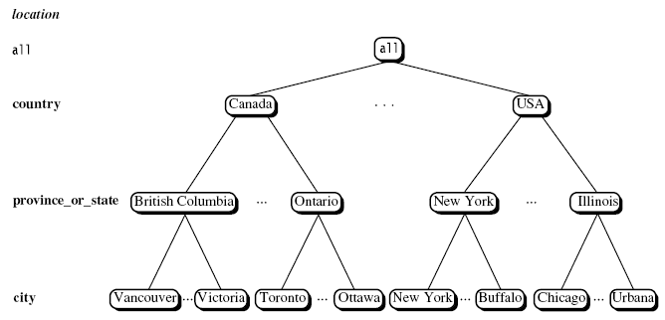
Concept Hierarchies
A concept hierarchy defines a sequence of mappings from a set of low-level concepts to higher-level more general concepts.

Slide 37
Concept hierarchies
Many concept hierarchies are implicit within the database schema.
for ex. Dimension location is described by the attributes number, street, city, state, zipcode, and country.
Many dimension may be organized in a prtial order, forming a lattice for ex. Partial order the time dimension is “day < { month< quarter; week} < year”

Slide 38
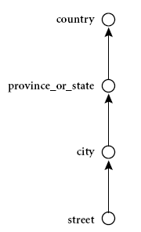
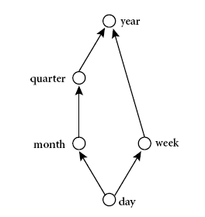
Concept Hierarchies

Slide 39
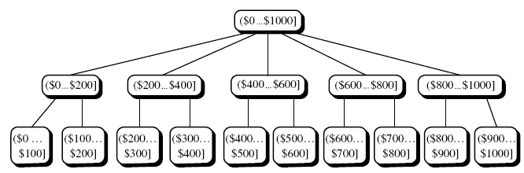
Concept Hierarchies
Concept hierarchies defined by discrediting or grouping values for a given dimension or attributes, known as set-grouping hierarchy.

Slide 40
A Sample Data Cube
Date
Total annual sales
of TV in U.S.A.
1Qtr
2Qtr
3Qtr
4Qtr
sum
Product
TV
PC
U.S.A
VCR
sum
Canada
Country
Mexico
sum
All, All, All

Slide 41
OLAP Operation
Roll up:
  The roll-up operation performs aggregation on a data cube, either by climbing up a concept hierarchy for a dimension or by dimension reduction.
  When roll-up is performed by dimension reduction, one or more dimensions are removed from the given cube.

Slide 42
Drill-down:
  Reverse of roll-up.
  It navigates from less detailed data to more detailed data.
  Drill-down can be realized by either stepping down a concept hierarchy for a dimension or introducing additional dimensions.
Slice: performs a selection on one dimension of the given cube, resulting in sub cube.
Dice: defines a sub cube by performing a selection on two or more dimensions.

Slide 43
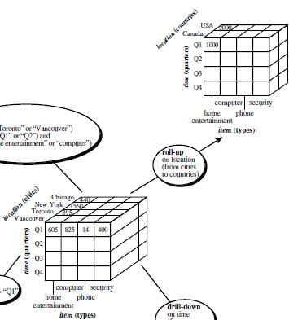

Slide 44
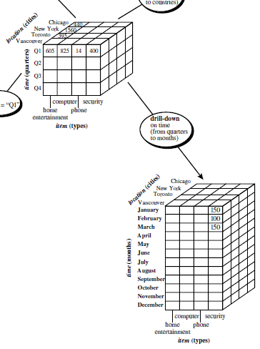

Slide 45
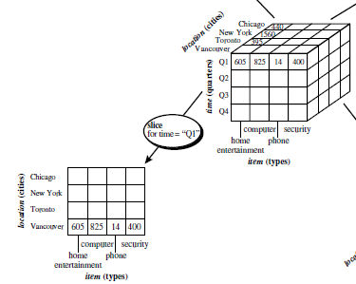

Slide 46
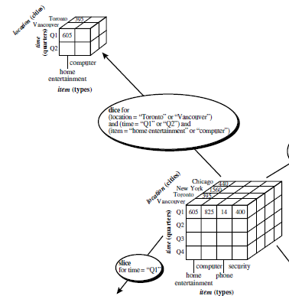

Slide 47
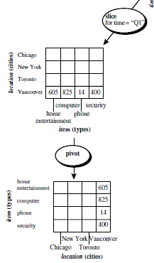

Slide 48
Starnet query model
The querying of multidimensional databases can be based on a starnet model.
A starnet model consists of radial lines emanating from a central point, where each line represents a concept hierarchy for a dimension.
Each abstraction level in the hierarchy is called a footprint.
These represent the granularities available for use by OLAP operations such as drill-down and roll-up.

Slide 49
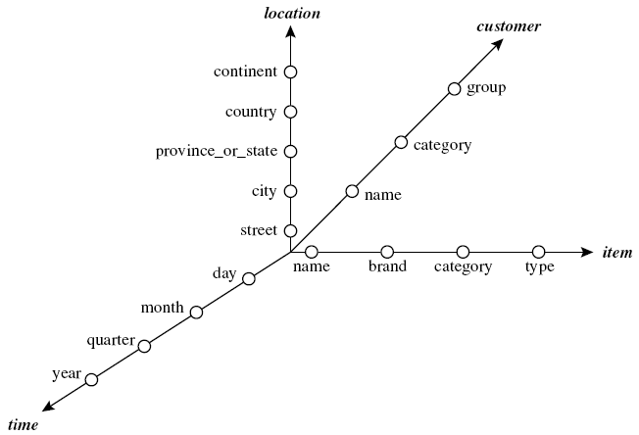

Slide 50
A Star-Net Query Model
Customer Orders
Shipping Method
Customer
CONTRACTS
AIR-EXPRESS
ORDER
TRUCK
PRODUCT LINE
Time
Product
ANNUALY
QTRLY
DAILY
PRODUCT ITEM
PRODUCT GROUP
CITY
SALES PERSON
COUNTRY
DISTRICT
REGION
DIVISION
Location
Each circle is called a footprint
Promotion
Organization

Slide 51
Chapter 3: Data Warehousing and OLAP Technology: An Overview
What is a data warehouse?
A multi-dimensional data model
Data warehouse architecture
From data warehousing to data mining

Slide 52
Design of Data Warehouse: A Business Analysis Framework
Building and using a data warehouse is a complex task because it requires:
  Business skills:
  Technology skills:
  Program management skills :

Slide 53
Data Warehouse Design Process
Typical data warehouse design process
  Choose a business process to model, e.g., orders, invoices, etc.
  Choose the grain (atomic level of data) of the business process
  Choose the dimensions that will apply to each fact table record
  Choose the measure that will populate each fact table record

Slide 54
Data Warehouse: A Three-Tiered Architecture
Monitor
&
Integrator
OLAP Server
Other
sources
Metadata
Analysis
Query
Reports
Data mining
Operational
DBs
Extract
Transform
Load
Refresh
Data
Warehouse
Serve
Data Marts
Data Sources
Data Storage
OLAP Engine
Front-End Tools

Slide 55
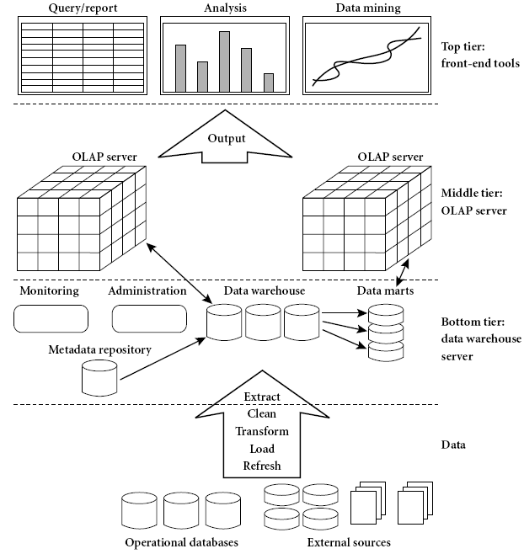

Slide 56
Design of Data Warehouse: A Business Analysis Framework
Warehouse database server:
  Almost always a relational database system.
  Back-end tools and utilities are used to feed the data.
  These tools and utilities perform data extraction, cleaning and transformation as well as load and refresh functions to update the data warehouse.
  The data are extracted using application program interfaces known as gateways. For ex. ODBC, JDBC.
  These tier also contains metadata repository.

Slide 57
Design of Data Warehouse: A Business Analysis Framework
OLAP server: middle tier, typically implemented using
    A relational OLAP(ROLAP) model, that is an extended relational DBMS, that maps operations on multidimensional data to standard relational operations.
    A multidimensional OLAP(MOLAP) model, that is a special purpose server that directly implements multidimensional data and operations.
Front-end client layer:
  Contains query and reporting tools, analysis tools and/or data mining tools.

Slide 58
Three Data Warehouse Models
Enterprise warehouse
  collects all of the information about subjects spanning the entire organization.
  Provides corporate-wide data integration, usually from one or more operational systems or external information providers.
  Contains detailed data, summarized data, and can range in size form a few gigabytes to hundreds of gigabytes, terabytes or more.
  Implemented on traditional mainframes, computer super servers, or parallel architecture platforms.

Slide 59
Three Data Warehouse Models
Data Mart
  a subset of corporate-wide data that is of value to a specific groups of users. Its scope is confined to specific, selected groups, such as marketing data mart
    Independent vs. dependent (directly from warehouse) data mart
    Independent data marts are sourced from data captured from one or more operational systems or external information providers or from data generated locally within a particular department or geographic area.
    Dependent data marts are sourced directly from enterprise data warehouses.
Virtual warehouse: A set of views over operational databases
  For efficient query processing only some of the possible summary views may be materialized

Slide 60
Data Warehouse Development: A Recommended Approach
Multi-Tier Data Warehouse
Distributed Data Marts
Enterprise Data Warehouse
Data Mart
Data Mart
Model refinement
Model refinement
Define a high-level corporate data model

Slide 61
Data Warehouse Back-End Tools and Utilities
Data extraction
  get data from multiple, heterogeneous, and external sources
Data cleaning
  detect errors in the data and rectify them when possible
Data transformation
  convert data from legacy or host format to warehouse format
Load
  sort, summarize, consolidate, compute views, check integrity, and build indicies and partitions
Refresh
  propagate the updates from the data sources to the warehouse

Slide 62
Metadata Repository
Meta data is the data defining warehouse objects. It stores:
Description of the structure of the data warehouse
  schema, view, dimensions, hierarchies, derived data defn, data mart locations and contents
Operational meta-data
  data lineage (history of migrated data and transformation path), currency of data (active or purge), monitoring information (warehouse usage statistics, error reports, audit trails)
The algorithms used for summarization
  Include measure and dimension definition algorithms, subject areas, aggregation, summarization, predefined queries and reports.

Slide 63
Metadata Repository
The mapping from operational environment to the data warehouse
  Includes, source databases and their contents, gateway descriptions, data partitions, data extraction, cleaning, transformation rules, security (user authorization and access control).
Data related to system performance
  Include indices and profiles that improve data access and retrieval performance, in addition to rules for the timing and scheduling of update, and replication cycles.
Business metadata
  Include business terms and definitions, ownership of data, charging policies.

Slide 64
OLAP Server Architectures
Relational OLAP (ROLAP)
  Use relational or extended-relational DBMS to store and manage warehouse data and OLAP middle ware
  Include optimization of DBMS backend, implementation of aggregation navigation logic, and additional tools and services
  Greater scalability
Multidimensional OLAP (MOLAP)
  Support multidimensional views of data through array-based multidimensional storage engine
  Fast indexing to pre-computed summarized data, faster computation.

Slide 65
OLAP Server Architectures
Hybrid OLAP (HOLAP) (e.g., Microsoft SQLServer)
  Combines ROLAP and MOLAP technology.
  Get benefit from the greater scalability of ROLAP and the faster computation of MOLAP.
  For ex HOLAP server may allow large volumes of detail data to be stored in a relational database, while aggregations are kept in a separate MOLAP store.
  Flexibility, e.g., low level: relational, high-level: array
Specialized SQL servers (e.g., Redbricks)
  Specialized support for SQL queries over star/snowflake schemas

Slide 66
Chapter 3: Data Warehousing and OLAP Technology: An Overview
What is a data warehouse?
A multi-dimensional data model
Data warehouse architecture
From data warehousing to data mining

Slide 67
Data Warehouse Usage
Three kinds of data warehouse applications
  Information processing
    supports querying, basic statistical analysis, and reporting using crosstabs, tables, charts and graphs
  Analytical processing
    multidimensional analysis of data warehouse data
    supports basic OLAP operations, slice-dice, drilling, pivoting
  Data mining
    knowledge discovery from hidden patterns
    supports associations, constructing analytical models, performing classification and prediction, and presenting the mining results using visualization tools

Slide 68
From On-Line Analytical Processing (OLAP) to On Line Analytical Mining (OLAM)
Why online analytical mining?
  High quality of data in data warehouses
    DW contains integrated, consistent, cleaned data
  Available information processing structure surrounding data warehouses
    ODBC, OLEDB, Web accessing, service facilities, reporting and OLAP tools
  OLAP-based exploratory data analysis
    Mining with drilling, dicing, pivoting, etc.
  On-line selection of data mining functions
    Integration and swapping of multiple mining functions, algorithms, and tasks

Slide 69
An OLAM System Architecture
Mining query
Mining result
Layer4
User Interface
User GUI API
OLAM
Engine
OLAP
Engine
Layer3
OLAP/OLAM
Data Cube API
Layer2
MDDB
MDDB
Meta Data
Filtering&Integration
Database API
Filtering
Layer1
Data Repository
Data cleaning
Data
Warehouse
Databases
Data integration

Slide 70
Chapter 3: Data Warehousing and OLAP Technology: An Overview
What is a data warehouse?
A multi-dimensional data model
Data warehouse architecture
From data warehousing to data mining
Summary

Slide 71
Summary: Data Warehouse and OLAP Technology
Why data warehousing?
A multi-dimensional model of a data warehouse
  Star schema, snowflake schema, fact constellations
  A data cube consists of dimensions & measures
OLAP operations: drilling, rolling, slicing, dicing and pivoting
Data warehouse architecture
OLAP servers: ROLAP, MOLAP, HOLAP
From OLAP to OLAM (on-line analytical mining)

